Slide 1
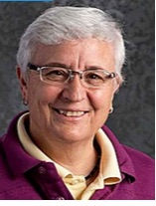
Peg Selig District 1

Slide 2
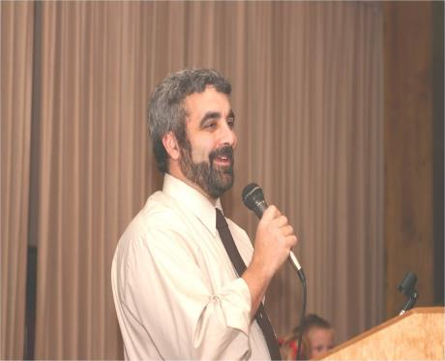
Greg Fazzari
District 9

Slide 3
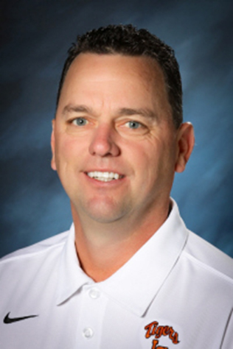
Jeff Norton
District 8

Slide 4
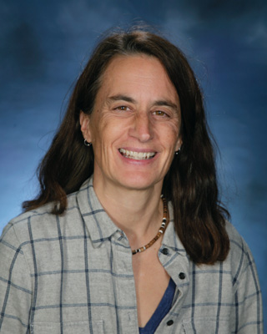
Cathy Schick
District 2

Slide 5
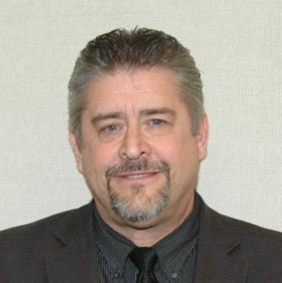
Rick Wells
District 3

Slide 6
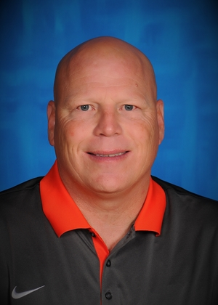
Jamie Nilles
District 7

Slide 7
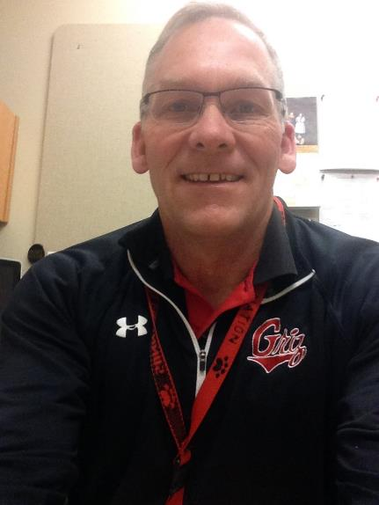
Bill Daley
District 6

Slide 8
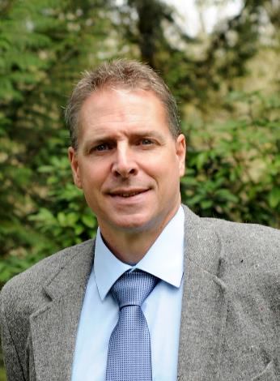
Neil Williamson
District 4

Slide 9
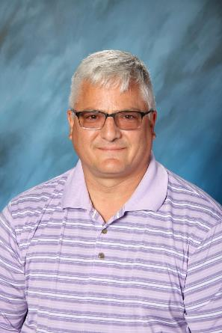
Steve Frucci
District 5

