Slide 1
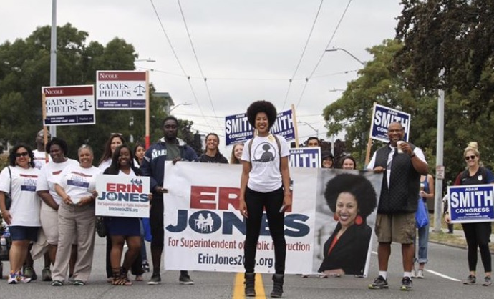
Winning in Life
In pursuit of a dream...

Slide 2
5 lessons learned on the run...
It’s not about where you start but where you finish.
Being average is easy. Just show up. Greatness is a to do more than just show up.
Say YES to challenge. Challenge makes you better.
Embrace failure. It’s necessary on the way to success.
You can do good things alone. Great things require a team.

Slide 3
It doesn’t matter where you start. Yesterday’s loss or failure does NOT have to determine tomorrow’s future. The challenges you or your staff or your students’ families experience cannot hinder future success.

Slide 4
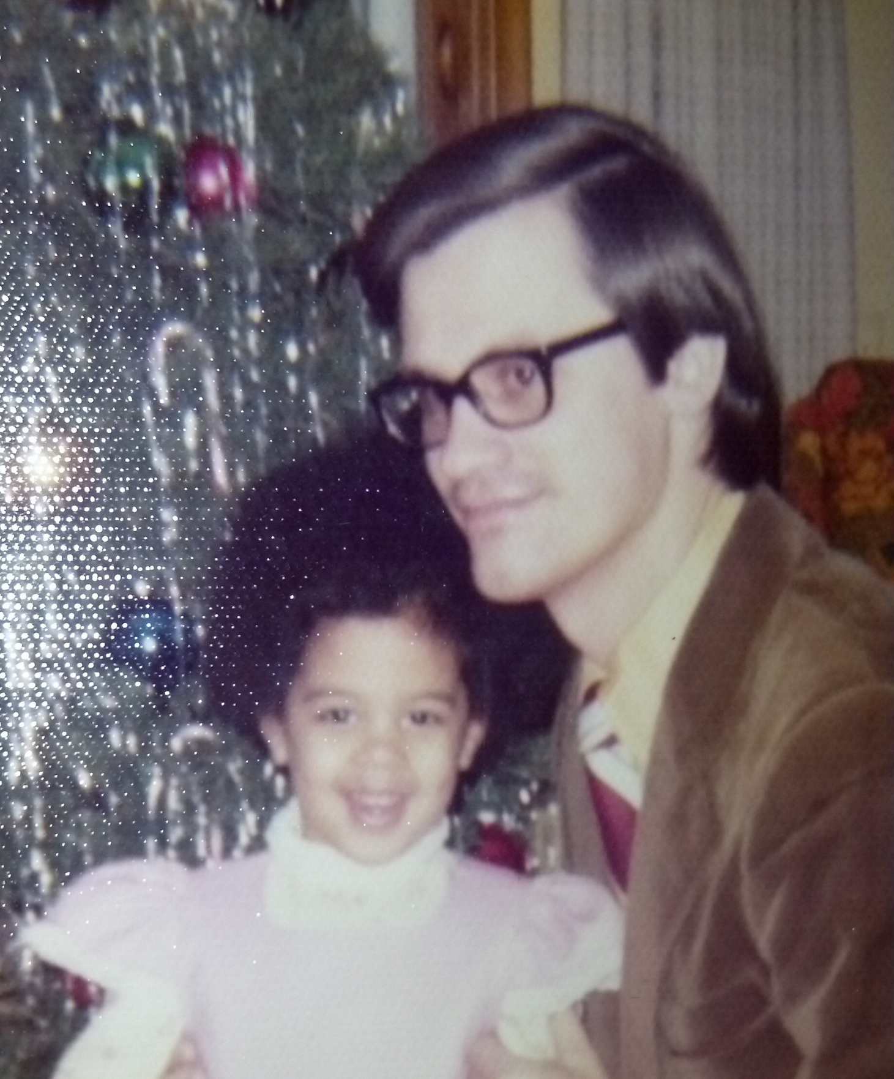

Slide 6
Being average is absolutely simple. All it requires is that you show up.
Being great requires doing more, investing more, giving all you have.

Slide 12
Say YES to challenge.
Do things that are bigger than you.
Whether you accomplish your goal or not, you will grow from it.

Slide 15
Failure is necessary on the path to success.
If you have big goals or big dreams, you need to be willing to fall down along the way.
Just make sure you don’t stay down when that day comes!

Slide 17
You can do some really GOOD things on your own, but GREAT things require a team!

Slide 21
My contact info:
erinjones93@gmail.com
Public Facebook (Erin Jones 2016)
Instagram (@erinin2016)
Twitter (erinjonesin2016)
LinkedIn (Erin Jones)

Slide 22
Guys - Coach Carter
https://youtu.be/J97F53CAA1I

Slide 23
Facing the Giants
https://youtu.be/-sUKoKQlEC4

Slide 24
Questions?

Slide 25
Create partnerships
Noon ______________
2:00 ________________
4:00 ________________
Listen to directions and create 3 partnerships:

Slide 26
So, what does this matter to you?
Making these lessons your own…

Slide 27
Take two minutes to…
Think about your favorite teammate. Write down the qualities that made this person a great teammate for you?
Think about your favorite coat. What are/were the qualities that made the skirts effective?
If you could accomplish two things as an athlete in the next year, what would they be?

Slide 28
Find your noon appointment
Who is/was the best player you have ever played with? What made that person so great? What were their skills/talents?
Who was your favorite team it? They may not have been the best player, but you enjoyed being on the same team with this person. What were their qualities?

Slide 29
Find your 2:00 appointment
Who is/was your favorite coach? Why?
Is there anything a coach has ever done that has made you want to quit or caused you to not play your best?

Slide 30
Find your noon appointment
If you could accomplish anything as an athlete in the next year, what would it be?
What will it take for you to reach that goal?
What is your greatest accomplishment so far as an athlete?

Slide 31
Circle activity
Stand in a circle around the outsides of the room.
Do not speak, and try to avoid making facial expressions.
Raise your hand every time you hear a statement that is true for you.

Slide 32
Break it up (1)
Mrs. Jones will call out a category.
Get yourself into groups based on how you identify with the category.

Slide 33
Guys – Coach Carter
https://youtu.be/eSBnFu1YnrU

Slide 34
Remember the Titans
https://youtu.be/aYp94Kk8AdE

Slide 35
Ladies and sports
http://www.wsj.com/video/women-athletes-and-balancing-sex-talent/6832B33C-C66E-497A-830C-0345D8670F78.html

