Slide 1
On-Line Athletic Forms
Bethel School District
Bryan Streleski
4/25/2016

Slide 2
Topics
BSD Process
BSD Development
BSD Forms
Skyward Integration
Challenges

Slide 3
BSD Process
Vendor 1
Vendor 2
Efficient system
Covers all needed information
$$$$$$
Excellent system
Covers all aspect of athletic program
More $$$$$$

Slide 4
BSD Process
Google
Skyward
Google Form
Google Sheet
No Cost
Family Access
My Activities
Emergency Information
More capabilities

Slide 5
BSD Development
Technology Department
Developing other forms
Connection to Family Access
Google Sheet
Similar spreadsheet to what was already used by AD’s
All Schools Participate
Three high schools & six middle schools

Slide 6
District Systems
What email system does your district use?
Do you use Skyward?
What information is already tracked in Skyward?
Do you use Family Access or similar system?

Slide 7
The Form
The Google Form
Submitted Forms – Stored & Emailed to Parent
The Data

Slide 8
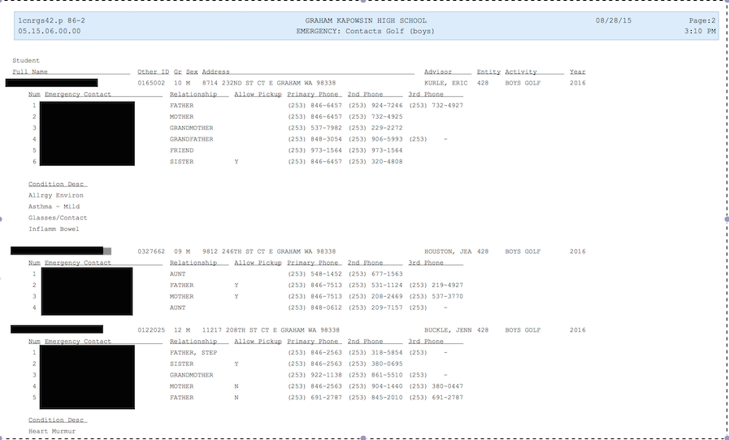
Emergency Information

Slide 9
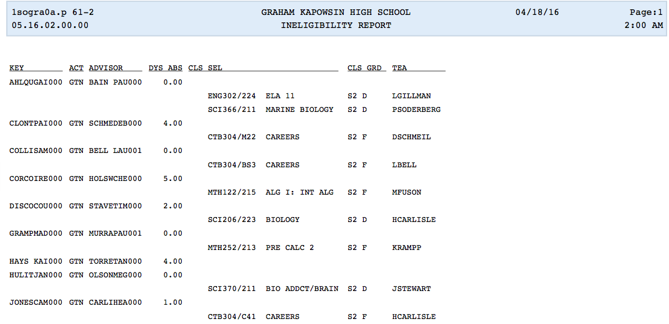
Grade Report

Slide 10
BSD Data
High School Data
Average 690 submitted forms per school
Middle School Data
Average 270 submitted forms per school
District Data
2014/15 – Cleared 3800 + students
2015/16 – Cleared 3800 + students

Slide 11
Challenges
No auto-fill option
No Yearly Rollover
Family Access Log-In Information
Navigation of form for parents
District teamwork

Slide 12
Questions?

