Slide 1
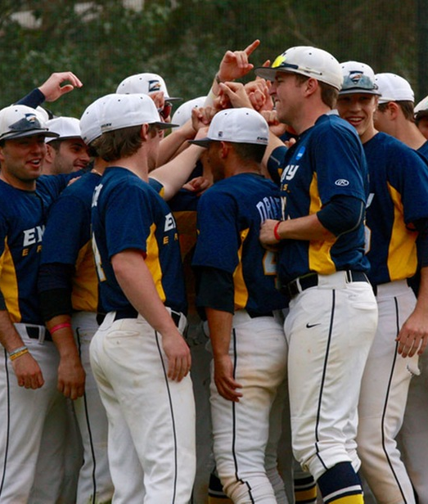
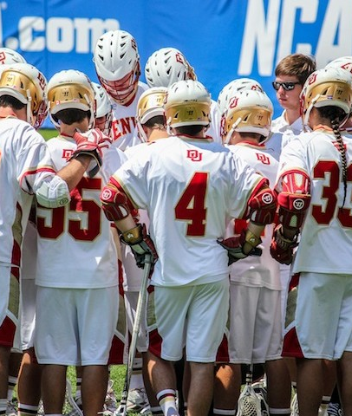
NCAA DI, DII and DIII Compliance
What high school athletic directors need to know about ncaa eligibility and recruiting

Slide 2
Agenda
What is the NCAA?
What is the NCAA Eligibility Center?
High School Timeline
Initial Eligibility Requirements for DI, DII, DIII
Retaining Amateurism Status
The Recruiting Process
Resources

Slide 3
NCaA Fast Facts
1,123 Colleges and Universities
Almost ½ million student athletes
19,500 teams
90 Championships
24 sports

Slide 4
What is the NCAA Eligibility Center?
They evaluate and certify prospective student athletes for collegiate competition at DI and DII.
Students who want to compete at NCAA DI or DII schools need to meet initial eligibility academic and amateurism requirements.
www.ncaa.org
http://www.ncaa.org/student-athletes/future/eligibility-center

Slide 5
High School Timeline
Grade 9: Plan
Work hard to earn best possible grades.
Ask counselor for list of NCAA approved core-courses.
Register for free profile page at eligibility center to receive reminders about NCAA academic and amateurism requirements.
Grade 10: Register
Register for profile page or certification account.
Communicate with counselor to stay on track.
If student athlete falls behind academically- ask for help.

Slide 6
High School TimeLine
Grade 11: Study
Check with counselor to confirm that required NCAA approved courses will be completed on time. (10/7 beginning of senior year).
Take the ACT or SAT and submit score to NCAA Eligibility Center using code 9999
At the end of the year ask counselor to upload official transcript.
Make sure you will graduate on time with your class.
Grade 12: Graduate
Complete final NCAA core-courses.
Request your final amateurism certification from certification account.
After graduation ask counselor to upload official transcripts with proof of graduation.

Slide 7
Initial-Eligibility Requirements
What is initial-eligibility?
Academic requirements that a college-bound student-athlete must meet in order to:
Practice,
Compete; and
Receive athletics aid (scholarship).
First year at a Division I or II institution.
Subsequent years governed by NCAA progress-toward-degree academic requirements.

Slide 8
Initial-Eligibility Requirements
Academic initial-eligibility requirements are different for Divisions I, II and III.
It is possible for a student-athlete to be eligible in one division and not another.
Eligibility Center certification is separate from the college admissions process.
It is possible for a student to be certified by the Eligibility Center but not meet the institution’s admissions standards. In addition, a student could meet the institution’s admissions standards but not be certified by the Eligibility Center.

Slide 9
Registration
Register for a Certification Account or Profile Page at www.eligibilitycenter.org to begin the process of becoming an NCAA student-athlete.

Slide 10
Two Account Types
Certification Account:
Division I and Division II
Domestic fee $80
Account information, school and sports history
Required for signing a National Letter of Intent (NLI) with a DI or DII NCAA school
Required to go on an official visit at a DI or DII NCAA school
Profile Account:
Undecided students
Division III students
Account information and school history
Can transition to a certification account at any time

Slide 11
What is a core-course?
NCAA core-courses include courses that:
Qualify for high school graduation in English, mathematics (Algebra 1 or higher), natural/physical science, social science, foreign language, or comparative religion or philosophy.
Are considered 4 year college-preparatory.
Are taught at or above the high school’s regular academic level.
Are taught by a qualified instructor.

Slide 12
What is a Core-Course?
TIP:
If you school is registered with the NCAA you can find your high school’s approved list of courses here: http://www.ncaa.org/student-athletes/future/eligibility-center/high-school-administrators.
If your school is not registered with the NCAA you can set up that account here: http://www.ncaa.org/student-athletes/future/high-school-account-review.

Slide 13
What is a Nontraditional course?
Course taught online or through:
Blended learning
Distance learning
Credit recovery
Independent study
Other similar means
*Taking nontraditional courses does not necessarily mean the student athlete is home schooled. If you have questions about Home School qualifications check out this Home School Toolkit provided by the NCAA: www.ncaa.org/student-athletes/future/home-school-students

Slide 14
Before you take a Nontraditional Course
Consider these requirements:
Must meet NCAA core-course requirements.
Must include regular ongoing access between instructor and student.
Must have a defined time period for completion.

Slide 15
DI Initial Eligibility academic Requirements
To play DI sports student athletes need to meet the following requirements:
Graduate high school on time.
Complete 16 NCAA approved core-courses in the correct subjects.
Earn a minimum GPA of 2.300.
Earn a combined SAT score or ACT sum score that matches your core-course GPA on the DI sliding scale. Find DI sliding scale at http://www.ncaa.org/static/2point3/.

Slide 16
DI Core-Course Time Limitation
Upon entering 9th grade a student athlete has 8 semesters to complete core-course requirements
If you do not complete high school on time any core-courses taken will not count toward NCAA requirements.
On time: If high school graduation is on June 1st, the student athlete must graduate June 1st.

Slide 17
DI Core-Courses
Complete 10 NCAA core-courses, including seven in English, math, natural/physical science, before the student athlete’s 7th semester (beginning of senior year).
Core-course requirements must be met in the time limitation.
English 4 years | Natural or Physical Science 2 years | Math (Algebra 1 or higher) 3 years | Social Science 2 years | Additional (English, math, or natural/physical science) 1 year | Additional (English, math, sciences, social science, foreign language, comparative religion, or philosophy) 4 year

Slide 18
Division I test scores
Take the SAT or ACT as many times as needed.
Use code 9999 when registering test scores as eligibility center.
EC uses the best scores to certify the student athlete:
SAT combined score
ACT SUM score
The SA test score and GPA will be matched on the DI sliding scale.
http://www.ncaa.org/static/2point3/

Slide 19
Division I Qualifier
A student athlete is eligible to practice, compete, and receive athletic aid their first year of college:
16 core-courses in the correct subjects.
10/7 core-course progression.
Minimum core-course GPA 2.3.
Combined SAT or sum ACT test score that matches their core-course GPA on sliding scale.

Slide 20
Division I redshirt
A student athlete may receive athletic aid and practice during the first academic term but not compete.
A student athlete must pass nine semester hours (eight credit hours) their first academic term to continue practicing the rest of the year.
Redshirts must meet the standard of:
16 core-courses
Minimum course GPA 2.0-2.299
Combined SAT or cum ACT score that matches their course GPA on the sliding scale
They may retake core-courses if they fail to meet the required 10 before their senior year.

Slide 21
Division II Initial-Eligibility Requirements
To play Division II sports a student athlete must meet the following academic requirements:
Graduate high school.
Complete 16 NCAA approved core-course requirements.
Earn a minimum GPA of a 2.2.
Earn a combined SAT or sum ACT test score that matches their GPA on the sliding scale.
Find the DII slide scale here: http://www.ncaa.org/division-ii-online-education-resource-center
Click on NCAA DII Manual and then scroll to page 127.

Slide 22
Division II core-Courses
Core-course time limitation
A student athlete can use all core-courses completed starting their ninth grade year until they enroll full time in a Division II college or university.

Slide 23
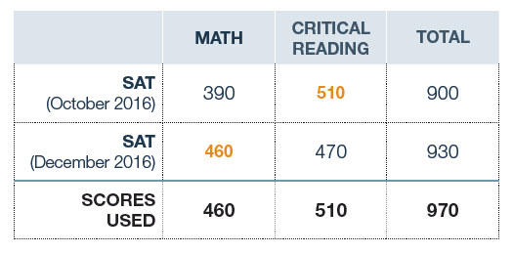
Division II test Scores
Take the SAT or ACT as many times as necessary.
Use code 9999 when registering at eligibility center.
They will use the best scores to certify athlete
SAT combine score
ACT sum score
Their test score and GPA will be matched in the DII slide scale

Slide 24
Division II Qualifier
A student athlete is eligible to practice, compete, and receive athletic aid for first year of enrollment.
16 core-courses in the correct subjects.
Minimum core course GPA of 2.2.
Combined SAT or cum ACT score that matches their core-course GPA on the full qualifier sliding scale.

Slide 25
Division II Partial Qualifier
Student athletes are allowed to practice and receive athletic aid but not compete during their first year.
Partial qualifiers meet these standards:
16 core-courses in correct subjects.
Minimum core-course GPA of 2.0.
Combined SAT or sum ACT score that matches their core-course GPA on the partial qualifier sliding scale.

Slide 26
Division III initial-eligibility requirements
Each Division III college or university determines its own eligibility for:
Admission
Financial Aid
Practice and Competition
The NCAA Eligibility Center does not perform certifications for Division III college-bound student-athletes.
Division III student athletes may register for a free Profile Page, but it is not required.

Slide 27
Amateurism status
The NCAA also evaluates amateurism status.
Have SA’s follow these tips to stay eligible and compete in college sports before full-time enrollment:
In general, amateurism requirements DO NOT ALLOW:
Contracts with professional teams.
Salary for participating in athletics.
Prize money above necessary and actual expenses.
Play with professionals.
Tryouts, practice or competition with a professional sports team.
Benefits from an agent or a prospective agent.
Agreement to be represented by an agent.
Delayed initial full-time college enrollment to participate in organized sports competition.

Slide 28
The Recruiting Process
Definitions:
Prospective Student Athlete: A student who has started classes for the ninth grade.
Contact: A face-to-face encounter between a PSA or their relatives, guardians(s) or individual of a comparable relationship and an institutional athletics department staff member or athletics representative during which any dialogue occurs in excess of an exchange of greeting.
Contact Period: During a contact period, a college coach may have face-to-face contact with a SA or their parents, watch the SA compete, visit high school, and write or telephone SA and/or parents.

Slide 29
The Recruiting Process
Dead Period: A college coach may not have any face-to-face contact with you or your parents on or off the college campus at any time during a dead period. The coach may write and call PSA or parents during this time.
Evaluation: An evaluation happens when a college coach observes a PSA practicing or competing.
Evaluation Period: During an evaluation period, a college coach may watch PSA compete, visit high school and write/telephone PSA and parents. However, a college coach may not have face-to-face contact with you or your parents off the college’s campus during an evaluation period.
Quiet Period: During this time, a college coach may not have any in person contact with PSA and parents off the college’s campus. The coach may not watch PSA play or visit high school during this time. PSA and parents can visit campus. A coach may write or call during this time.

Slide 30
The Recruiting Process
Official Commitment: When the PSA official commits to attend a Division I or Division II college, they sign a National Letter of Intent, agreeing to attend that school for one academic year.
Celebratory Standardized Signing Form: This form is only used by Division III institutions. This is a form provided by the NCAA. It is a nonbinding athletics celebratory signing form after a college-bound student athlete has been accepted for enrollment at a Division III school.

Slide 31
General rules for the recruiting process
Division I
Coaches can call PSA, and send electronic correspondence by September 1st of junior year.
PSA can call coaches at any time.
PSA can receive recruiting materials September 1st of junior year.
Off-campus contact varies by sport.
Basketball – beginning of junior year (not in April)
W. Basketball – March 1st of junior year
Other sports – July 1st before senior year
Official visit can occur at the beginning of senior year. (exception basketball, football).
Limit to one official visit per institution. Max time=48 hours. DI has a maximum of 5 official visits total.

Slide 32
General Rules for the recruiting process
Division II
Coaches can call PSA and send electronic correspondence starting on June 15 before junior year.
PSA can call coaches at any time
PSA can receive recruiting materials starting on June 15 before junior year
Off-campus contact between coach and PSA can start on June 15 before junior year.
Official visit can occur starting on June 15 before junior year

Slide 33
General Rules for the Recruiting process
Division III:
Coaches can call PSA and send electronic correspondence anytime.
PSA can call coaches at anytime.
The institution and coaching staff can send recruiting material to PSA anytime.
Off-campus contact can occur upon the conclusion of the PSA sophomore year in high school.
Official visits cannot occur until January 1st of junior year.

Slide 34
resources
Visit these websites for more information
www.ncaa.org/playcollegesports
www.eligibilitycenter.org
Get updates on Twitter @NCAAEC and Instagram @playcollegesports.
Visit www.nationalletter.org to learn about the National Letter of Intent.
Download these resources:
http://www.ncaa.org/student-athletes/future/educational-resources
http://www.ncaa.org/compliance?division=d3
Select Division III Manual
http://www.ncaa.org/division-ii-online-education-resource-center
Select NCAA Division II Manual
http://www.ncaa.org/compliance?division=d1
Click on Legislative Services Database (LSDBI) and then search for your topic.

