Slide 1
The power of culture and personal story
How do we better serve all students?

Slide 2
The plan:
Introductory activities
Establish common language
Lots of moving, partner-talk, reflecting, large group discussion.

Slide 3

introductory activity
Who is in the room?

Slide 4
Who is in the room?
Your name
The location where you work
Your role
Why you came to this session

Slide 5
Circle activity
Stand in a circle around the outsides of the room.
Do not speak, and try to avoid making facial expressions.
Raise your hand every time you hear a statement that is true for you.

Slide 6

Make appointments
Make 2 appointments with others in this room- noon, 2:00,

Slide 7

Critical terms
Language is important!
Let’s make sure we're on the same page!

Slide 8
achievement gap
The term “Achievement Gap” evokes a deficit model, suggesting that students from certain communities are incapable of achieving at the same level as their white and Asian counterparts.

Slide 9
Opportunity Gap
Strength-based term that speaks to the lack of access many students have to resources that lead to academic success:
authentic engagement of families and community
smooth transitions for all students at every level
culturally-relevant curriculum
highly-quality, experienced educators (that means YOU)
positive role models
high expectations
academic English (while showing value for home language)

Slide 10
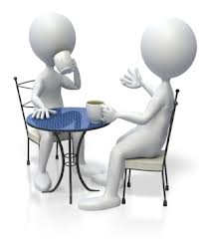
find your noon appointment
Share your thoughts about the terms we covered - achievement gap vs. opportunity gap.
How does reframing the “issue” as opportunity gap change how we respond?
Which solutions are most relevant for the work you do?

Slide 11
Think - Pair - share
Take 2 minutes to write your own brief definitions for diversity, equity (vs. equality).
Turn to a partner in your area and share your responses.
Be prepared to share with the whole group.

Slide 12
Diversity, Equity, Equality
Diversity: wanting to acknowledge and, possibly, celebrate, the differences between people. Typically focused on compliance or the superficial ways people are different.
Equality: treating everyone the same and providing everyone with the same opportunities/resources.
Equity: giving students whatever they need to be successful (will be different, depending upon the student).

Slide 13
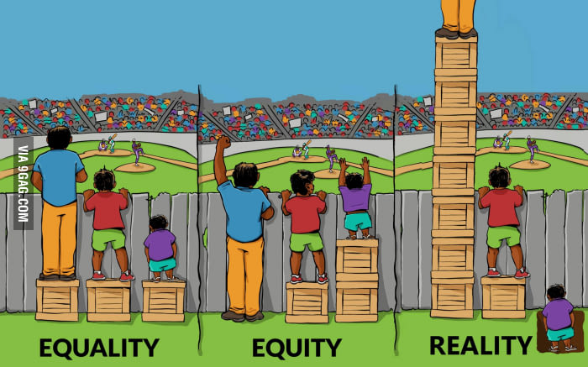

Slide 14
find your 2:00 appointment
Share your thoughts about the terms we covered - diversity, equality vs. equity.
What are the roles each play in how you engage in school spaces?

Slide 15
Race vs. ethnicity vs. culture

Slide 16
Race in "simple" terms
This is a term that is misunderstood everywhere!
What others see.
Not biology.
Created in order to perpetuate power structures.

Slide 17
Ethnicity in short
Guess WHat? You might not claim/have an ethnicity.
Nation/people group "of origin" + language + traditions + culture.
Ethnicity is something you choose to identify as (or not).

Slide 18
Culture in short
We’ve all got it!
'...the set of attitudes, values, beliefs, and behaviors shared by a group of people, but different for each individual, communicated from one generation to the next.'
Matsumoto 1996: 16

Slide 19
find your 4:00 appointment
Share your thoughts on what you heard regarding the definitions of the terms:
Race
Ethnicity
Culture

Slide 20

Break it up
Erin will call out a category.
Get yourself into groups based on how you identify with the category.

Slide 21
Culturally-Responsive practice
"Cultural responsiveness is the ability to learn from and relate respectfully with people of your own culture as well as those from other cultures."
National Center for Culturally Responsive Educational System
http://www.niusileadscape.org

Slide 22
Find your 6:00 appointment
What are the roles equity and culturally-responsive practice play in your work as an educator?
How can you move the needle in the role in which you serve?

Slide 23

Learning through moving
Four Corners - culture in action

Slide 24
Four corners
Corner 1: I completely agree.
Corner 2: I am unsure.
Corner 3: Sometimes.
Corner 4: I completely disagree.

Slide 25

Being on time is important in my family
Corner 1: I completely agree.
Corner 2: I am unsure.
Corner 3: Sometimes.
Corner 4: I completely disagree.

Slide 26

Having individual bedrooms for each child is important
Corner 1: I completely agree.
Corner 2: I am unsure.
Corner 3: Sometimes.
Corner 4: I completely disagree.

Slide 27

There is a lot of noise in my house
Corner 1: I completely agree.
Corner 2: I am unsure.
Corner 3: Sometimes.
Corner 4: I completely disagree.

Slide 28
find your 10:00 appointment
What is your most important learning about yourself and others after engaging in the 4 Corners activity?

Slide 29
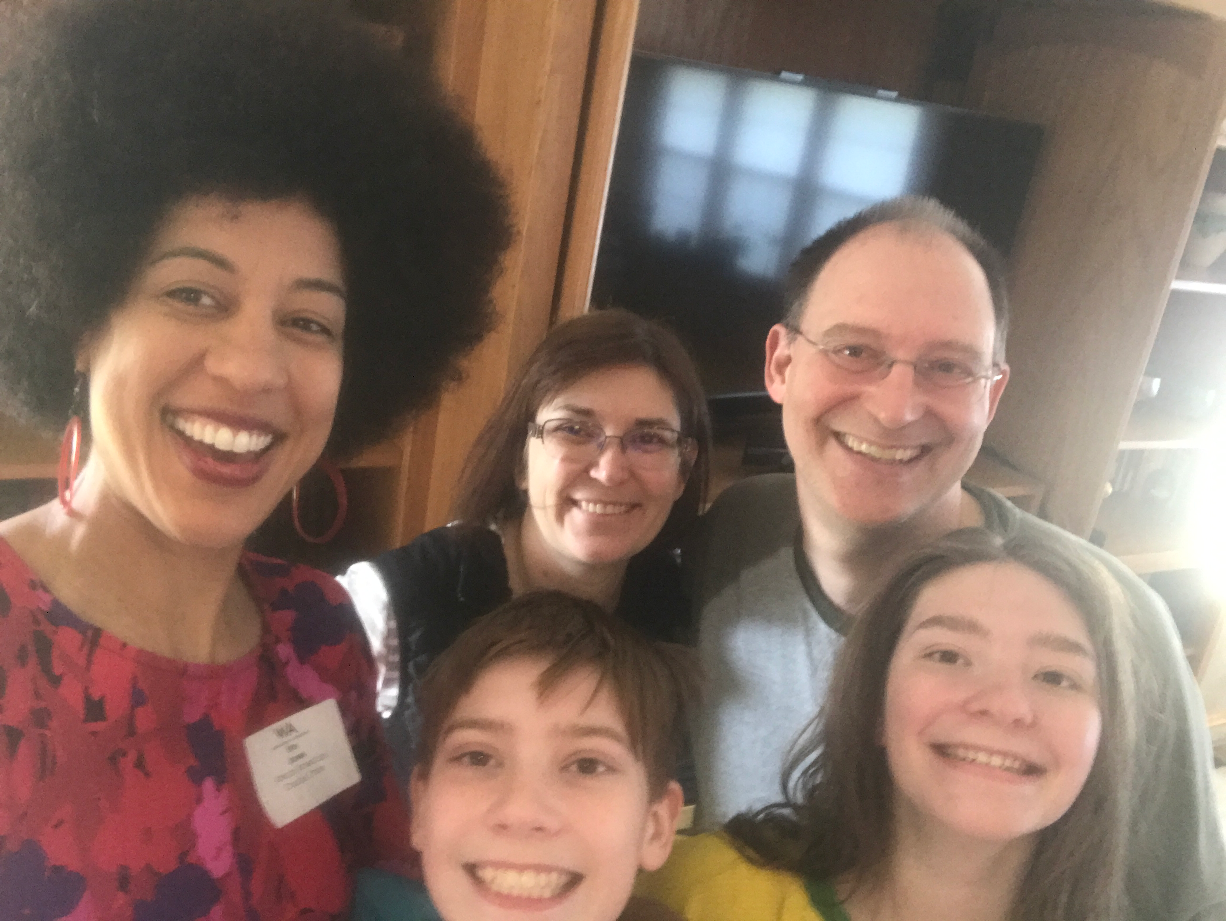
The role of your story
What do you bring to the table? How did you develop your own sense of culture?

Slide 30

Knowing your story is the key to effectiveness
Our story is an expression of our culture.
Telling the story is a culturally-relevant practice.
The story helps us to remember why we do this work.
The story helps to create connections.

Slide 31

Timeline
On a sheet of paper, create a personal timeline with the 10 events that have made the most impact on your life - the good, the bad, the ugly.

Slide 32
find your noon appointment (part 1)
Please share your responses to the following questions:
Which person/event in your story threatened to destroy you?
Which person/event propelled you forward?
Is there an event that completely changed the direction of your life?

Slide 33
Noon appointment (part 2)
Where have you lived throughout the course of your life?
With whom have you lived?
Who is the friend you have had the longest?

Slide 34
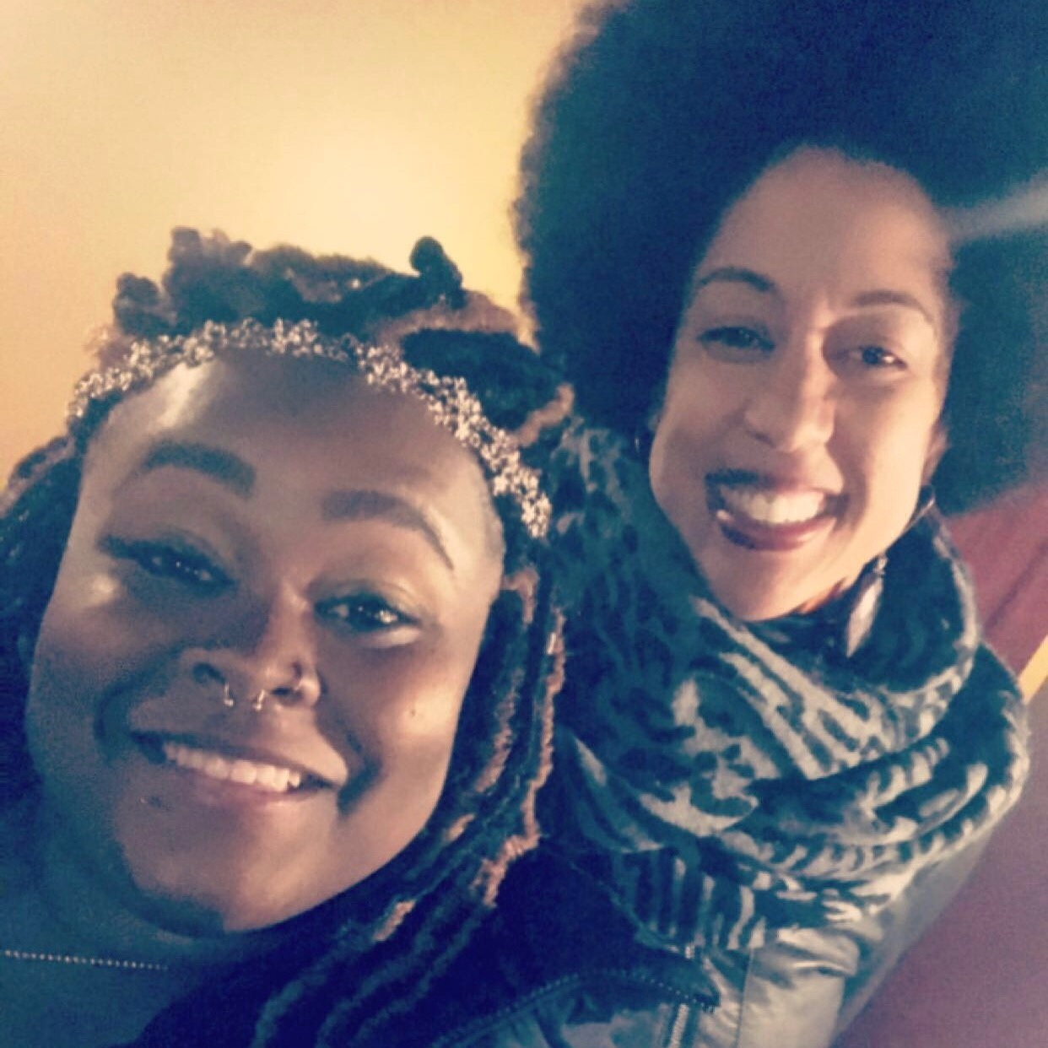
10:00 appointment - picture time!
Time to pull out your phone...
Select 3 pictures that best represent what is important to you.

Slide 35
Additional resources
https://www.ted.com/talks/howard_c_stevenson_how_to_resolve_racially_stressful_situations
https://www.ted.com/talks/sally_kohn_what_we_can_do_about_the_culture_of_hate
https://learnerlog.org/socialstudies/who-am-i-help-students-explore-their-identity/
https://sites.lsa.umich.edu/inclusive-teaching/sample-activities-templates/
https://www.nytimes.com/interactive/2018/03/19/upshot/race-class-white-and-black-men.html
https://mobile.nytimes.com/2017/03/15/learning/lesson-plans/25-mini-films-for-exploring-race-bias-and-identity-with-students.amp.html
https://mic.com/articles/140882/what-is-reverse-racism-here-s-why-it-doesn-t-actually-exist-in-the-united-states
https://www.ted.com/talks/chimamanda_adichie_the_danger_of_a_single_story
https://youtu.be/KvLj3OIQHuE - Racial Imposter Syndrome

Slide 36
My contact info:
erinjones93@gmail.com
Public Facebook (Erin Jones 2016)
Instagram (@erinin2016)
Twitter (erinjonesin2016)
LinkedIn (Erin Jones)

