Slide 1
Keeping Football Healthy
An Athletic Director’s Perspective
Greg Whitmore
Athletic Director
Head Football Coach
Lind-Ritzville High School

Slide 2
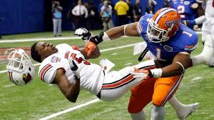
We have to change the culture of football.
How our coaches coach.
Reassess our youth programs.
I am going to challenge your thinking.

Slide 3
Topics for Today:
Decline in football participation numbers & why
How we have to monitor the way our coaches coach
Rule changes – some we have & some we may need
The state of youth football & select football

Slide 4
How is football really doing?
Pop Warner saw participation drop 9.5 percent between 2010-12 according to ESPN report.
2010 248,899
2012 225, 287
USA Football - participation among players ages 6 to 14 fell from 3 million to 2.8 million in 2011, a 6.7 percent decline.

Slide 5
NFHS Athletics Participation Survey:
Football had the 2nd largest decline in participation from 2013 - 2014. (9,599 less)
What will 2015 look like?

Slide 6
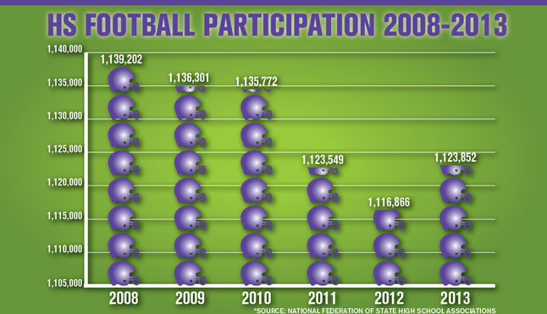
2014 – 1,114,253

Slide 7
Why the Decline?
Sport Specialization
Rising Costs to Participate
Lack of Interest / Societal Changes
Concussions - Risk of Injuries

Slide 8
We have to educate parents.
We know that early specialization:
Does not guarantee future athletic success (scholarships)
Leads to overuse injuries
Increases chances that kids will burn out and quit sports
Decreases likelihood kids will stay active in sports as adults

Slide 9
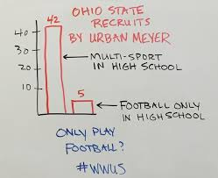
Sport Specialization

Slide 10
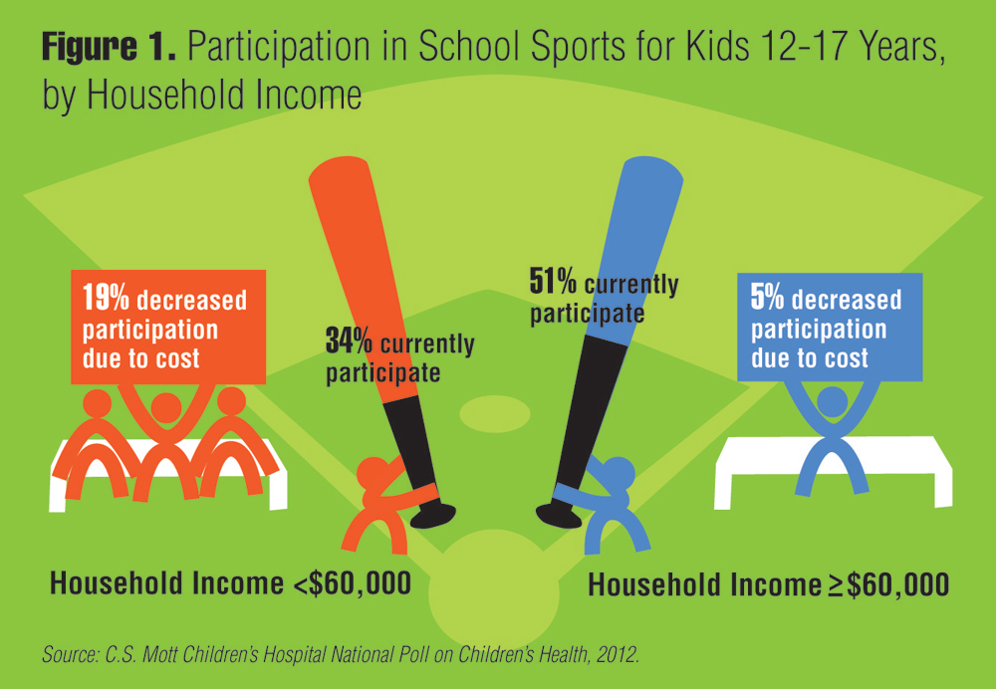
Rising Cost of Participation
WIAA will be looking at socio-economic factors as it relates to athletic success and classification

Slide 11
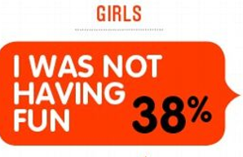
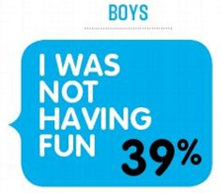
Lack of Interest
Societal Changes (video game generation)
Kids Getting Burned Out
Not Having Fun
How does Pete Carroll make practice fun?

Slide 12
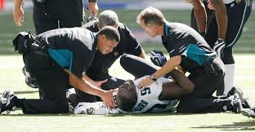
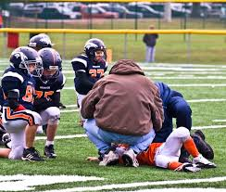
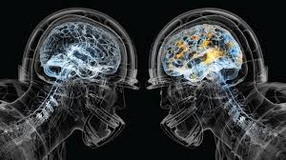
Risk of Injury/Concussions

Slide 13
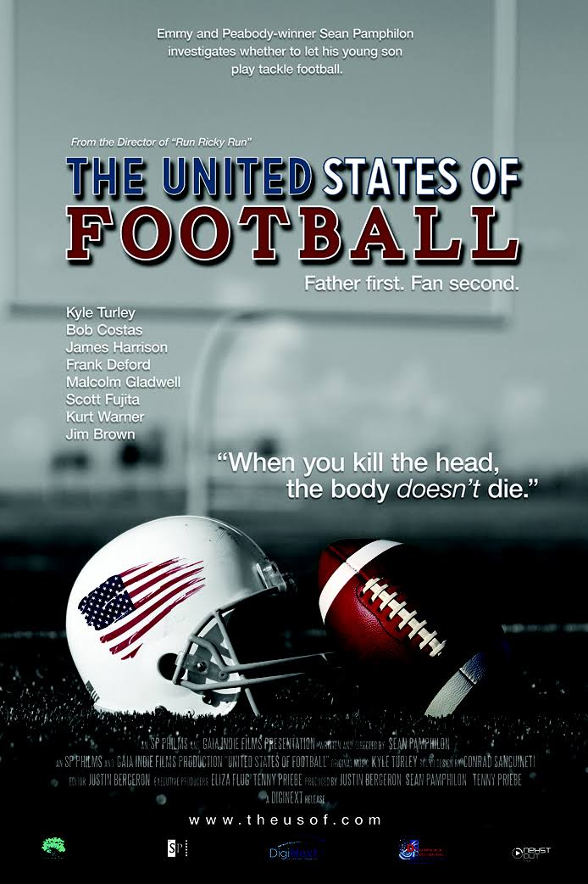
www.theusof.com
Sean Pamphilon
“Father first. Fan second.”
Rent or buy on iTunes

Slide 14
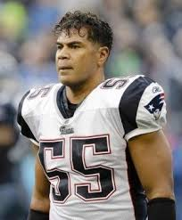
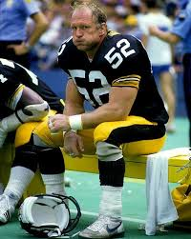
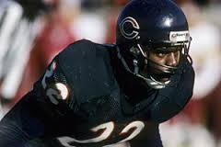
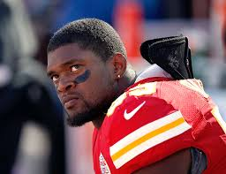
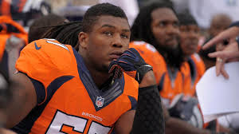
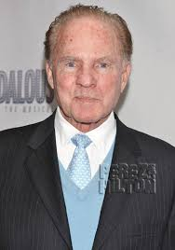
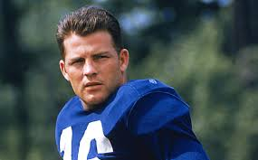
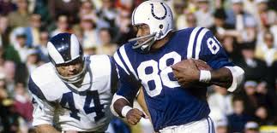
Chronic Traumatic Encephalopathy (CTE)
Junior Seau
Mike Webster
Dave Duerson
Jovan Belcher
Adrien Robinson
John Mackey
Frank Gifford

Slide 15
Research indicates CTE is real, but……..
The key word of this disease is “Chronic.”
These players experienced repeated “Trauma.”
These players often had multiple concussions.
These players returned before brain healed.
Many, many more sub-concussive hits.
Players in the news are high profile.

Slide 16
What can we do as AD’s?
Help change the culture!

Slide 17
Youth Football – Pop Warner
We have to address Youth Football.

Slide 18
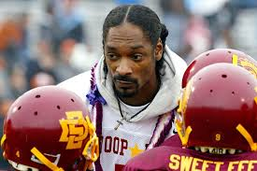
Youth Football – Pop Warner
Least qualified people coaching the most important group

Slide 19
Youth Football – Pop Warner
We have to rethink youth football!

Slide 20
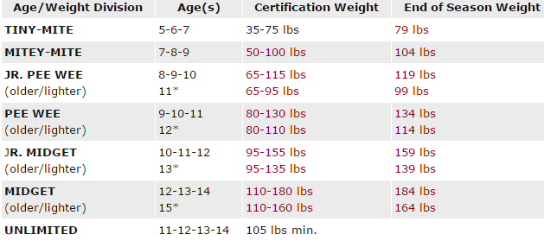
When should kids start hitting?

Slide 21
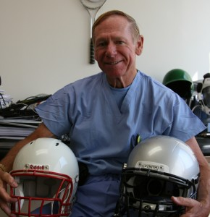
Dr. Robert Cantu
Child’s head/brain disproportionate size
Lack neck strength
Brain not fully developed
Youth brain more susceptible to trauma
Youth brain doesn’t heal as quickly.

Slide 22
Let’s Propose a Rule Change Today
No tackle football before 9th grade
Dr. Cantu
Keyshawn Johnson
No tackle football before 7th grade
No tackle football before 5th grade

Slide 23
Youth Football in your Area?
What age does it start?
Do you have Select football?
Middle School – City League - Select
How much influence do you have?
How much influence does your coach have?

Slide 24
Flag football

Slide 25
We have to have conversations w/coach.
Coaches must rethink how they coach.
Changes to practices.
Don’t teach dangerous hits.
Don’t celebrate dangerous hits.

Slide 26
Don’t teach/celebrate dangerous hits

Slide 27
What Else Must We Do as AD’s?
The Givens

Slide 28
Parent Meetings:
Get correct information to parents.
Help parents keep things in perspective.
2013 Deaths Due to Football
Directly Related 8
Indirectly Related 9
17 deaths
2013 Bicycle Deaths in U.S.
10-14 30
15-19 49
79 deaths

Slide 29
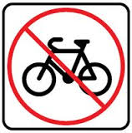
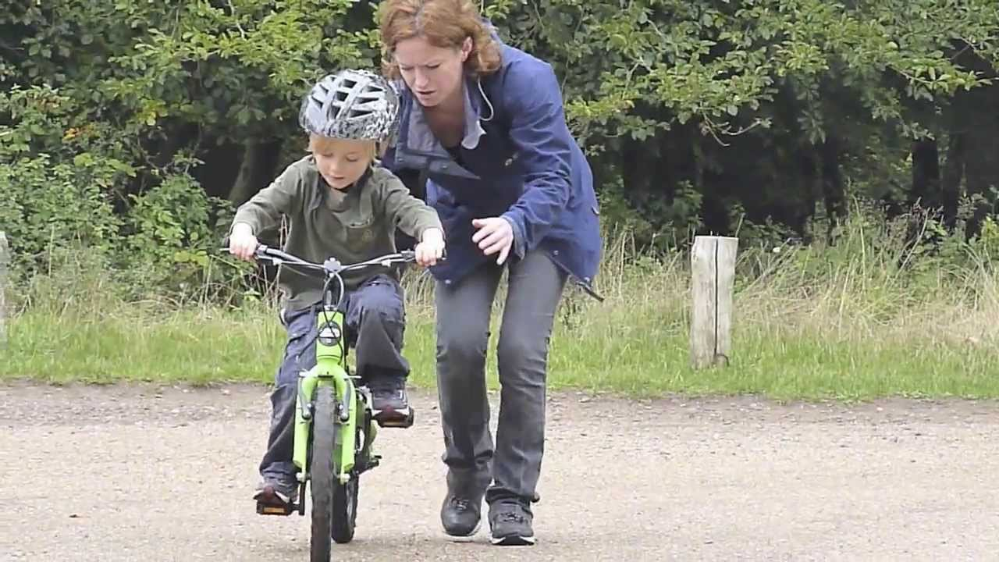
Anyone not letting their kid ride a bike?

Slide 30
Parent Meetings:
Rule Changes to Make Football Safer
Summer practice limitations
No more than 2 contact days/week (WIAA Amendment proposed again)
Targeting Defenseless Players
Helmet-to-Helmet
Kickoff Formation Rules

Slide 31
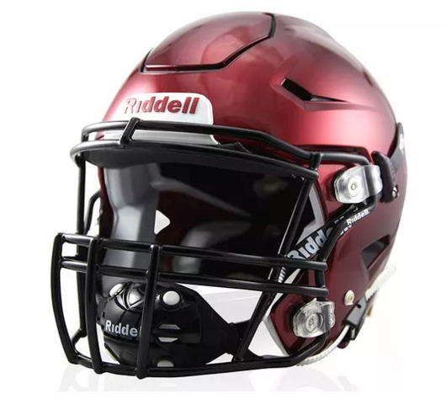
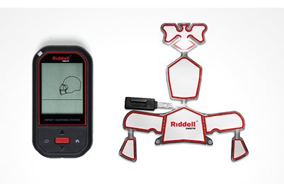
Technology/Equipment

Slide 32
Parent Meetings:
Invite them to practices.
Show our coaches teaching safe technique.
Make them know that their son or daughter will never get to the point that players they see on TV do.

Slide 34
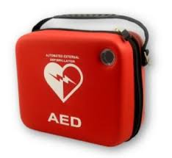
Within 3 minutes

Slide 35
Return to Play Protocol:
Baseline: Back to School First
Step 1: Light Aerobic Activity
Step 2: Moderate Activity
Step 3: Heavy, Non-contact Activity
Step 4: Practice & Full Contact
Step 5: Competition

Slide 36
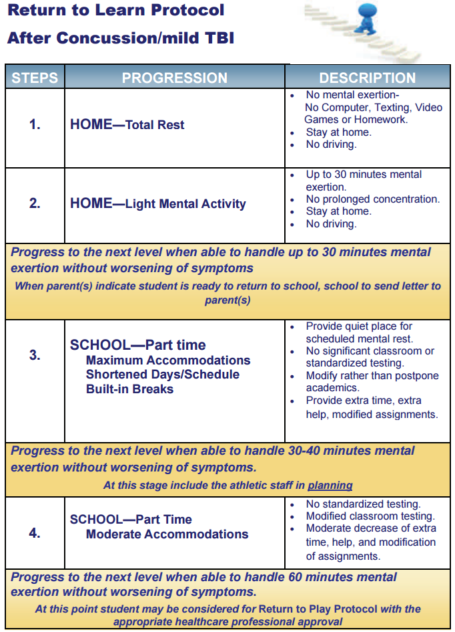
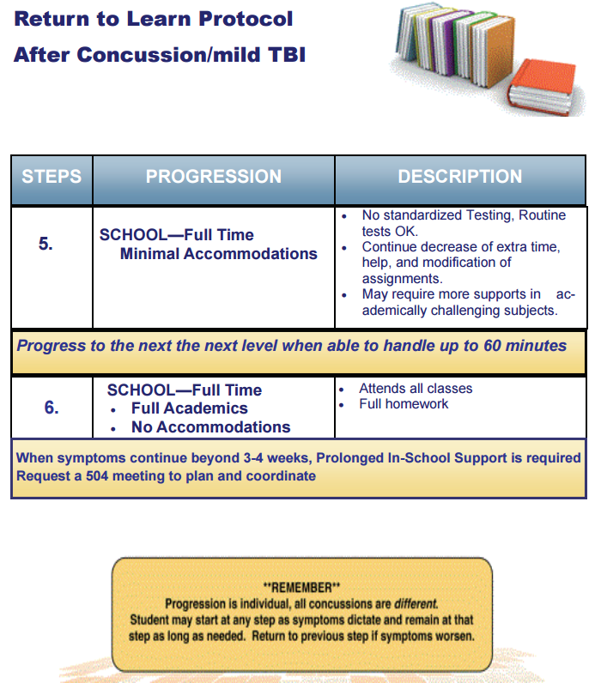

Slide 37
HIGH SCHOOL - HELMET INVENTORY - (2015)
HEL # | Size | Manuf. | Style | Mold / ID # | Initial Season | Recond | Recond | Recond | Recond | Recond | Recond
1 | M | Riddell | Speed |  | Sept. 2013 | 2015
2 | M | Riddell | Speed |  | Feb. 2012 | 2014
3 | M | Riddell | Speed |  | Feb. 2012 | 2014
4 | M | Riddell | Speed |  | Feb. 2012 | 2014
5 | M | Riddell | Speed |  | 2014
6 | M | Riddell | Speed |  | 2013 | 2015
7 | M | Riddell | Speed |  | 2013 | 2015
8 | M | Riddell | Speed |  | 2015
9 | M | Schutt | DNA | 111088HR | 2008 | 2011 | 2013 | 2014
10 | M | Riddell | Speed |  | 2015
11 | M | Schutt | DNA | 010527HR | 2007 | 2011 | 2013 | 2015
12 | M | Schutt | DNA | 010527HR | 2007 | 2011 | 2013 | 2014
13 | M | Riddell | 360 |  | 2012 | 2014
14 | M | Riddell | Speed |  | 2014
15 | L | Riddell | Speed |  | Feb. 2012 | 2014
16 | L | Riddell | Speed |  | Feb. 2012 | 2014
17 | L | Riddell | Speed |  | Feb. 2012 | 2014

Slide 38
We have to keep making football safer.
But the truth is..…..
Football has never been safer!

Slide 39
Questions/Comments?
Greg Whitmore
gwhitmore@lrschools.org
509-659-5020

