Slide 1
Providing Coaching Education Opportunities For Your Staff
WSSAAA Conference
Spokane Washington
April 11, 2011

Slide 2
Presented By:
Terry Cavender
Athletic Director
Camas School District
Terry.Cavender@camas.wednet.edu
Rick Wells
Director of Health, Fitness and Athletics
Puyallup School District
wellsjr@puyallup.k12.wa.us

Slide 3
SESSION CONTENT
Assessing the Need
Checklist for Planning
Developing the Syllabus
Seminar Content an Examples
Summary & Conclusions

Slide 4
Assessing the Need
Historical Rationale and Purpose:
The purpose of coaching education is to bring about a positive outcome regarding the development of coaches, the improvement of performance, and the enhancement of athletic services available to students.
WIAA Coaching Standards & Expectations
Professional & Legal Expectations
Methodology

Slide 5
Checklist for Planning
FACILITIES
CLOCK HOUR /COACHES EDUCATION HOUR OFFERING
SECURING PRESENTERS
ACCOUNTING
PUBLICATIONS
REGISTRATION PROCESS
LAST MINUTE STUFF

Slide 6
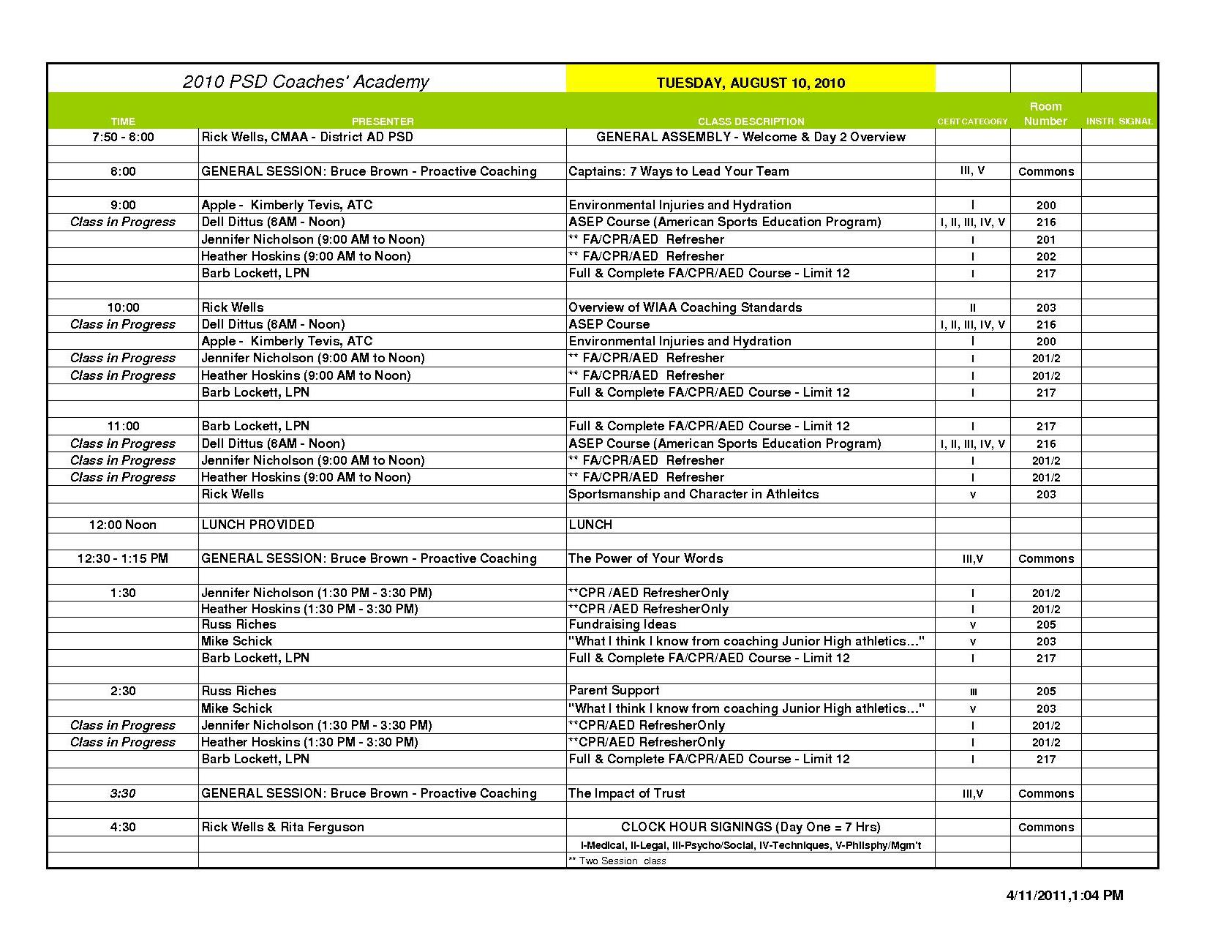
Developing the Content and Syllabus

Slide 7
Seminar Content & Examples
WIAA Coaching Standards
Life & Death Issues For Coaches
Pitfalls, Tips, & Expectations
Team & Asset Building
Coaching For Character
Hazing & Harassment In Athletics
Toxic Competition
Title IX Quiz
Coaching Evaluations
Coaches Checklist
Transportation Protocols
Improving Communication With Parents
et. al.,

Slide 8
Summary & Conclusions
Terry Cavender
Athletic Director
Camas School District
Terry.Cavender@camas.wednet.edu
Rick Wells
Director of Health, Fitness and Athletics
Puyallup School District
wellsjr@puyallup.k12.wa.us

