Slide 1


Sportsmanship Ideas
for Your League
Patrick Brown, AD
Squalicum High School | NW Conference
patrick.brown@bellinghamschools.org

Slide 2
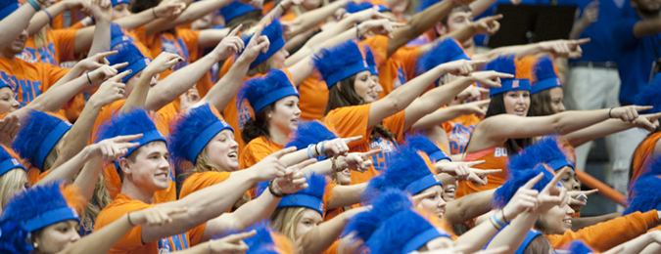
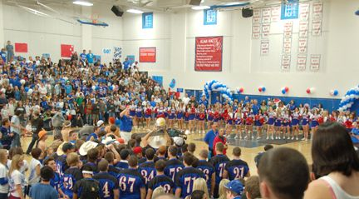
Goals: League and School
School Spirit
Positive Rivalries
Home Field/Court
Advantage
Integration:
Fans, Cheer Squad and Band
Interleague Cooperation

Slide 3

Challenges
Media
The Message
Lack of Attention
Administrator Buy In
League Cooperation

Slide 4
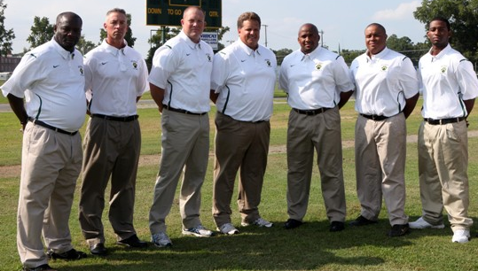
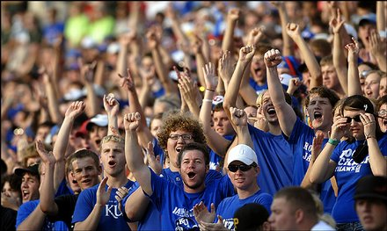
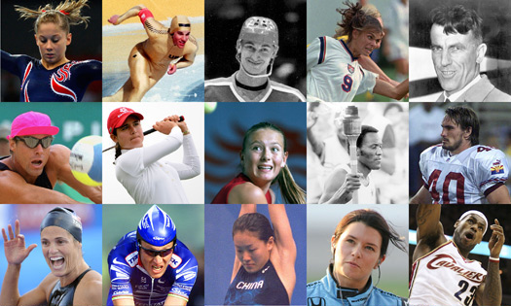
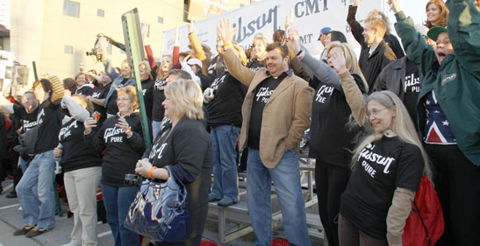
Constituents
Coaches
Student Section
Athletes
Sportsmanship
Parents and
Other Fans

Slide 5

Conference Level
League Constitution -
Clearly Defined Expectations
“Just Play Fair” –
Leaders in Sportsmanship
Northwest Conference
Sportsmanship Forum
League Brochure
LASC (Formerly Interhigh)
Purpose of the Northwest Conference Sportsmanship Forum
To develop and implement a positive league sportsmanship model. Our ultimate goal is to emphasize positive sportsmanship and character within the overall framework of the public and private school mission.

Slide 6


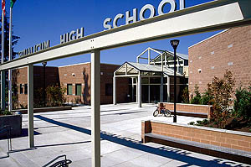
School Level
Point of Emphasis
Coaches Preseason Meetings
Team Preseason Meetings
Parent Preseason Meetings
Storm Soldiers
Cheer Squad
Band
Game Management - Administrator Buy In

Slide 7

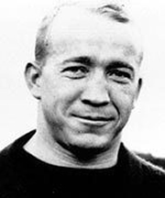

Slide 8
Purpose of the Northwest Conference Sportsmanship Forum
To develop and implement a positive league sportsmanship model. Our ultimate goal is to emphasize positive sportsmanship and character within the overall framework of the public and private school mission.
Why you!?!
You were selected to attend because of your potential as a student leader. In addition, you were selected to assist in building upon and continuing the positive sportsmanship tradition of the NWC.

Slide 9
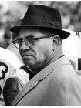
“Winning isn’t everything.
It’s the only thing.”
Vince Lombardi 1965
Won five NFL titles
Won Super Bowls I and II
Current Super Bowl trophy named in his honor
“I wish to [heck] that I’d never said [that] thing….I meant the effort…I meant having a goal. I sure as [heck] didn’t mean for people to crush human values and morality.”
Vince Lombardi 1970

Slide 10
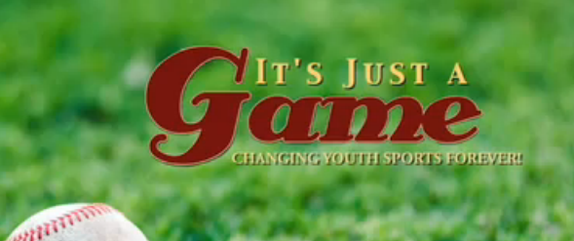
Notes:
http://www.youtube.com/watch?v=vg7JuVv1hlc&feature=related

Slide 11
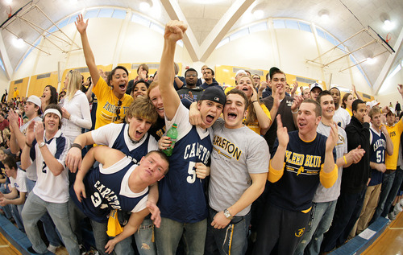
Development Phase One
How do we define sportsmanship?

Slide 12

Northwest Conference Sportsmanship Program
“Just Play Fair”
  The Northwest Conference is strongly committed to sportsmanship and responsible behavior of participants, coaches, cheerleaders, spectators, students and adults, from all member schools. Although many people display appropriate behavior, it is important to teach and
  re-emphasize sportsmanship and responsible
  behavior as part of an ongoing program.

Slide 13
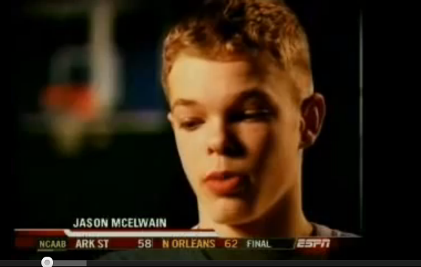
Notes:
http://www.youtube.com/watch?v=Tui8EOdv_VU&feature=related

Slide 14
“Weakness of attitude becomes weakness of character.”
Albert Einstein
Foundations of the NWC Sportsmanship Model
Character Driven
Integrity
Respect
Maturity
Enthusiasm
Responsibility and Accountability
Victory with Honor-Defeat with Dignity
Commitment to Community

Slide 15
Development Phase Two
Identify coaches and athletes (at any level) that you have observed demonstrating good or bad character and sportsmanship.
Describe specific actions that caused you to think that each of these coaches or athletes possessed positive or negative character traits.
What character traits are exemplified by these actions?

Slide 16
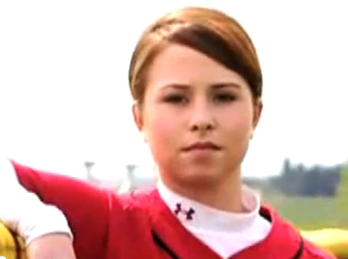
Notes:
http://www.youtube.com/watch?v=yaXVk5GBx-s&feature=related

Slide 17
Development Phase Three
As a high school athletic director, you have been asked to make the argument that learning about character and sportsmanship in sports is an important objective of your school’s athletic programs. Outline for parents and community members the points to include in your presentation.
Explain why this is an essential part of your program.
How do athletes benefit?
What is the benefit for your school?
What is the benefit for your community?
What is your recommendation for strategies that schools could use to build character and promote sportsmanship?

Slide 18












Development Phase Four
Rate your school

Slide 19
Sportsmanship Ideas
for Your League
What Works
For You?

Slide 20
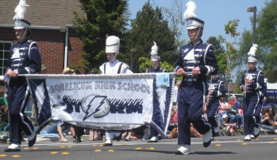
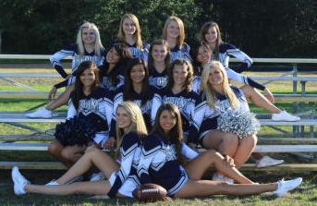
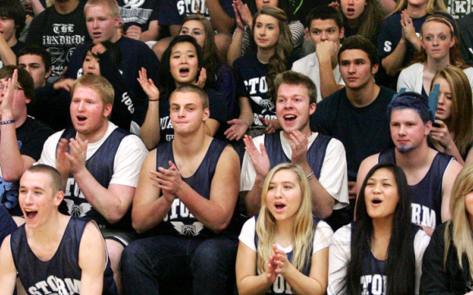
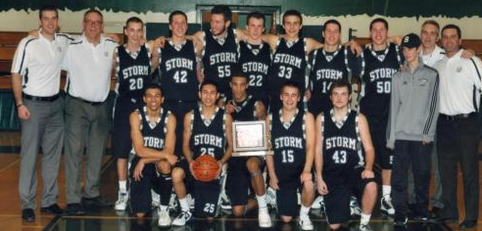
Sportsmanship Ideas
for Your League
Patrick Brown, AD
Squalicum High School | NW Conference
patrick.brown@bellinghamschools.org

