Slide 1
JEFF BAINES
SUMNER HIGH SCHOOL

Slide 2
Impact & Influence
Community
Culture
Leadership
Learning

Slide 3
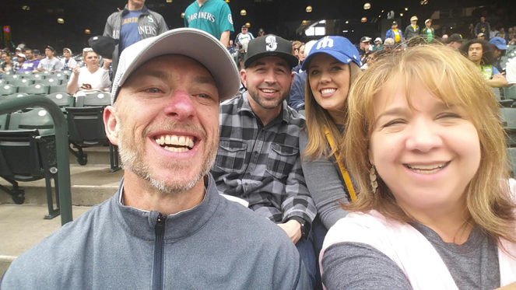
Self Reflection
Think of a person who has had a positive influence in your life. What made their influence so impactful?
On the post it – Write down this persons name and a reminder of their impact on your life, career, beliefs, etc…
Hang on to this post it.

Slide 4
Hopeful Outcomes
Make you stop and think about why you do what you do
Make you realize the impact you can have on your athletes, coaches, school and community
Share my journey with you and provide a few ideas to steal or adapt to your own
Think about what’s next for you on your journey

Slide 5
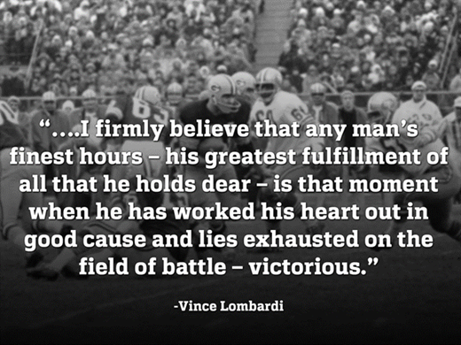
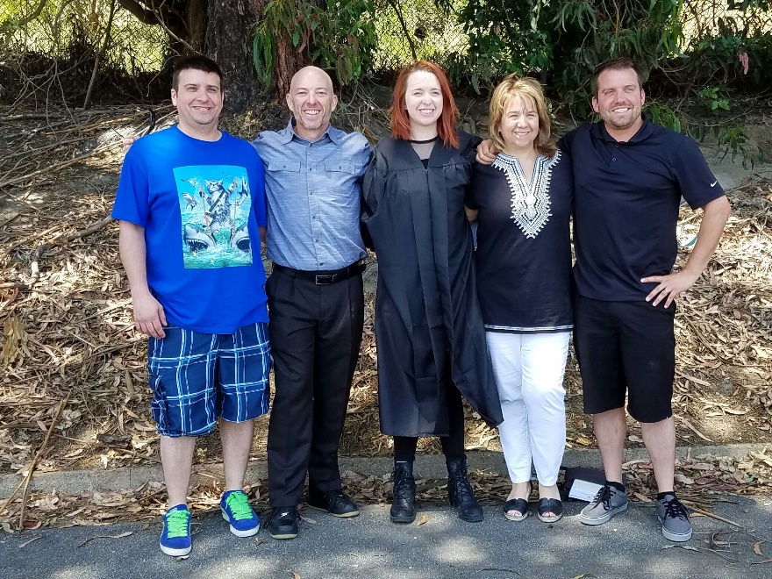
A Little About Myself

Slide 6
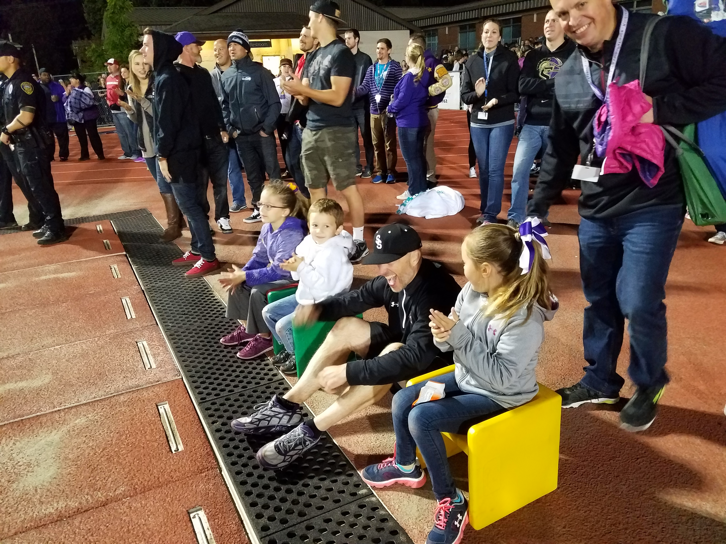
A Little About Myself

Slide 7
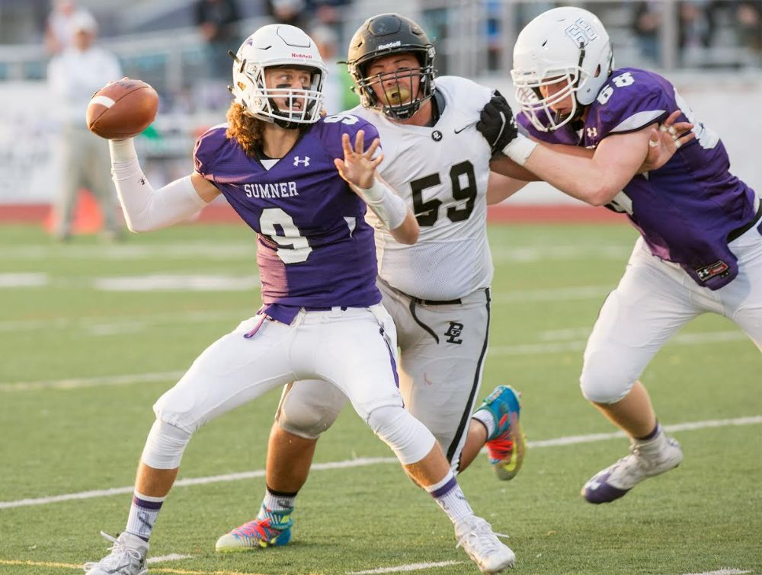
NOW LET’S GET MOVING

Slide 8
It Starts With a PURPOSE – YOUR WHY

Slide 9
Start each day with opportunity to grow and learn…
Books
Videos
Journals
Social Media
You Tube
Whatever the method, take the time for yourself to grow and to honor you and what you do each and every day.
Make an Impact like Johnny

Slide 10
Something about me…
“MAKE TODAY BETTER THAN YESTERDAY AND LET TOMORROW TAKE CARE OF ITSELF.”
Jeff Baines
MY WORD = COURAGE

Slide 11
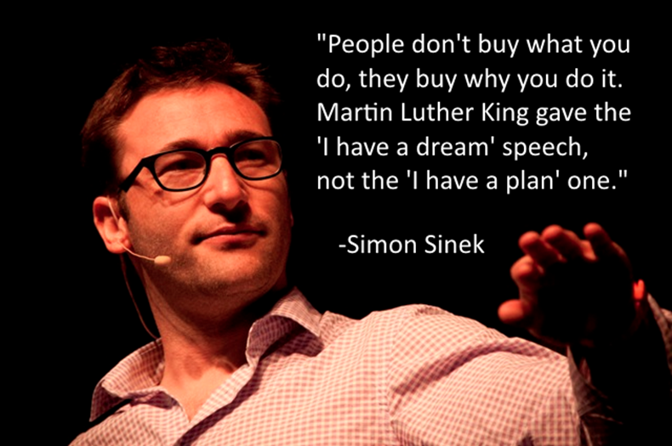
Great Thoughts…

Slide 12
Your influence will be felt
Stay true to you purpose because others will benefit…Even if you do not realize it

Slide 13
8 ESSENTIALS = FOUNDATION
PATIENCE
KINDNESS
HUMILITY
SELFLESSNESS
RESPECT
FORGIVENES
HONESTY
COMMITMENT

Slide 14
KINDNESS
Two set out to impact their team
The results were amazing!

Slide 15
PATIENCE
Set out to be a positive role model for:
Coaches
Athletes
Parents
Fans
Community
Show empathy when the time is right
Be the steady ship in rough seas

Slide 16
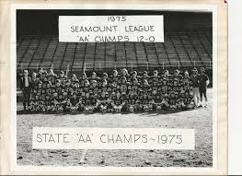
HUMILITY
Honor the past, the present and the future
Do not forget your roots and what got you to your current
It is WE before ME (Jon Gordon)
Well DONE is better than well said
(Jon Gordon)

Slide 17
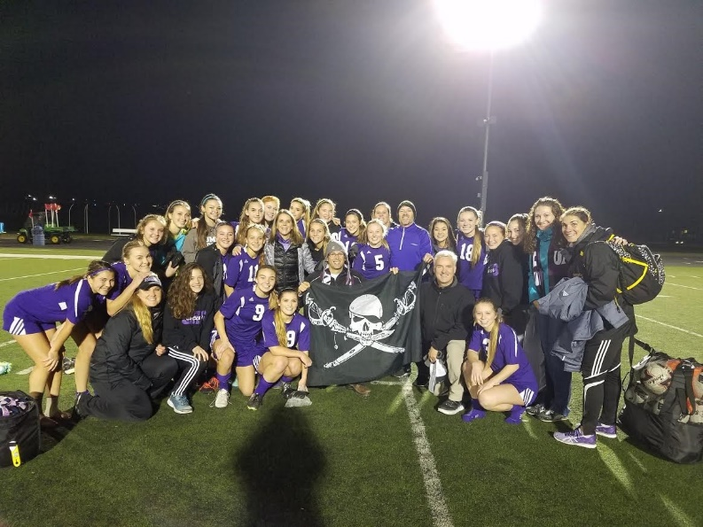
RESPECT
Treating others as they are the most important people in the world
Athletes
Coaches
Officials
Parents
Fans
Press

Slide 18
SELFLESSNESS
Be There
“Coaches-coach & AD-AD”s”
Always find a way to honor what your athletes and coaches are doing
Do not expect anything in return – Serve
Don’t forget to say “Thank You”

Slide 19
FORGIVENESS
Always remember to forgive yourself first…This is a hard job!
Learn from where we have been…Don’t live in it
Through the adversity we grow, we learn, we become better

Slide 20
HONESTY
Integrity is a critical part of who we are as a:
Person
Teammate
Spouse
Friend
Without integrity, there is no GRIT
Grateful
Respectful
Integrity
Team
(Motto from 15-16 school year)

Slide 21
HONESTY

Slide 22
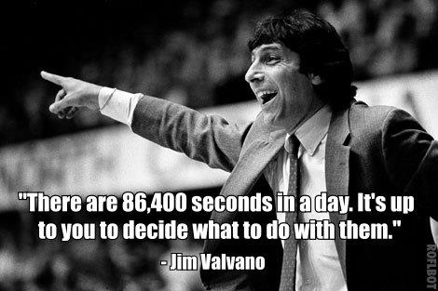
COMMITMENT
Stick to your choices
Have the confidence you have made the right decision for your school
Do not be afraid to seek out others along the way
Put the needs of your school and program FIRST – Servant Leadership

Slide 23
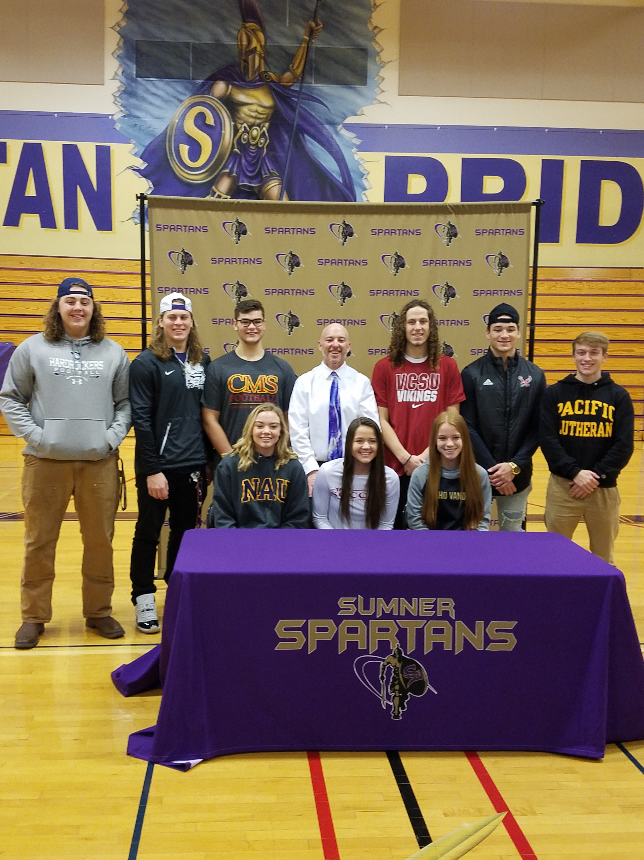
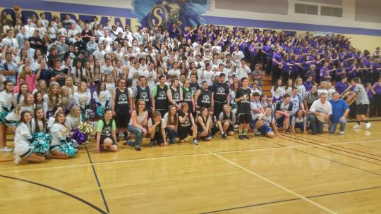
Some things to look at…
Signing Days
Pack the Gym

Slide 24
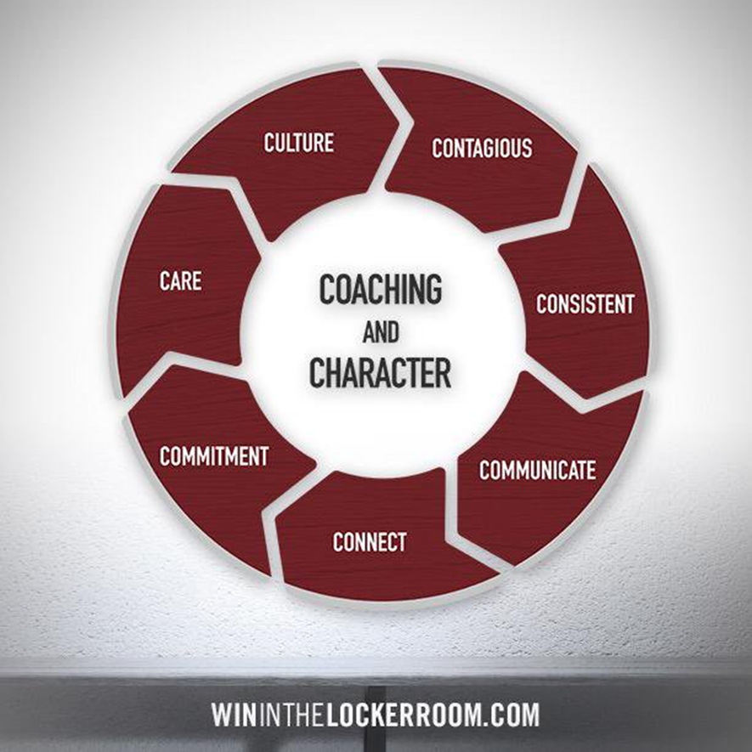
Some things to look at…
Sumner Athletic Alliance (Athletes)
Bagels with Baines (Coaches)

Slide 25
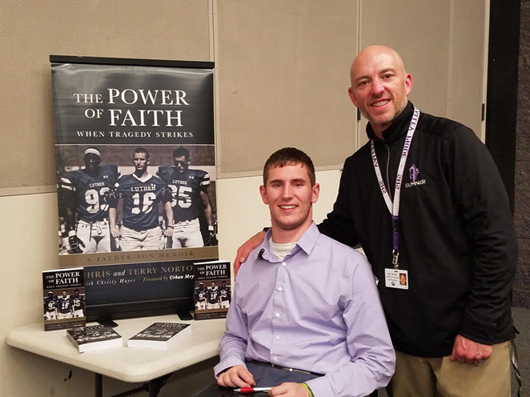
Some things to look at…
Guest Speakers
Coaches Professional Development
Chris Norton @ Sumner High School

Slide 26
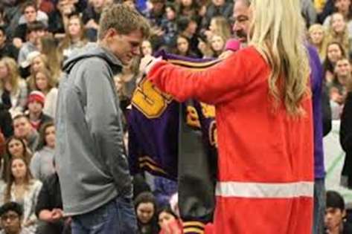
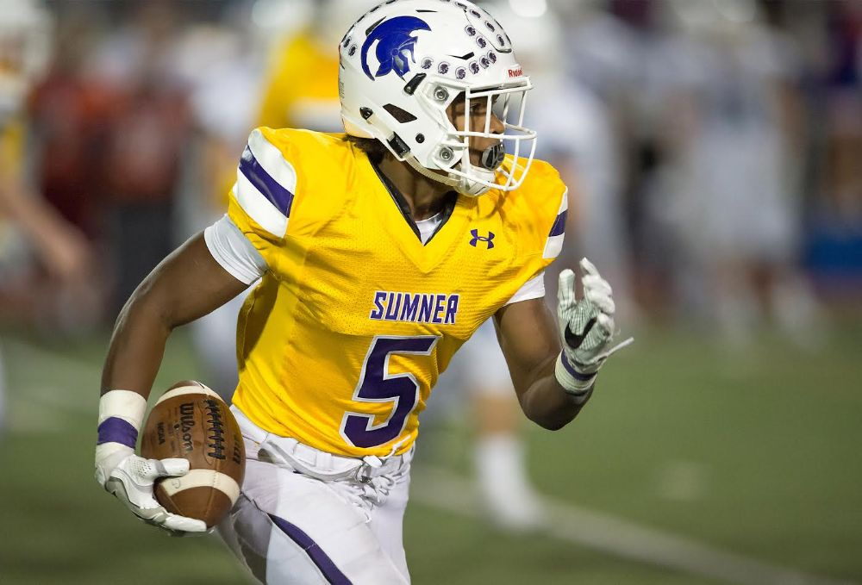
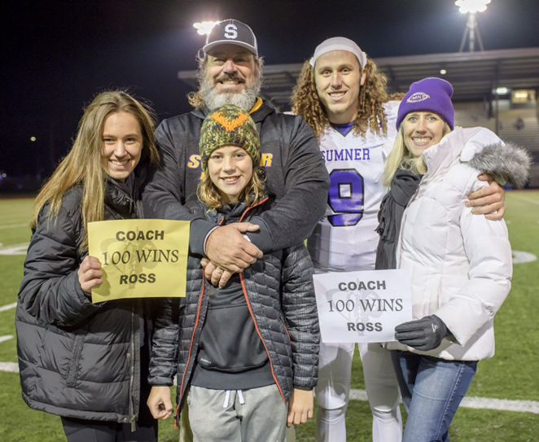
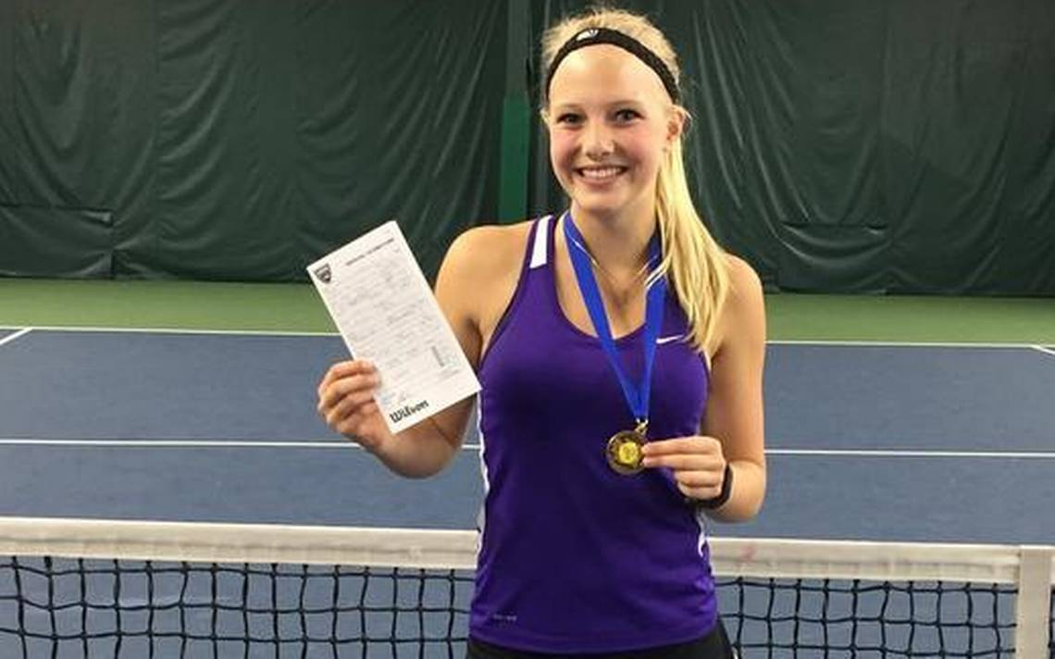
Some things to look at…
Celebrate Others
It starts at “HOME”

Slide 27
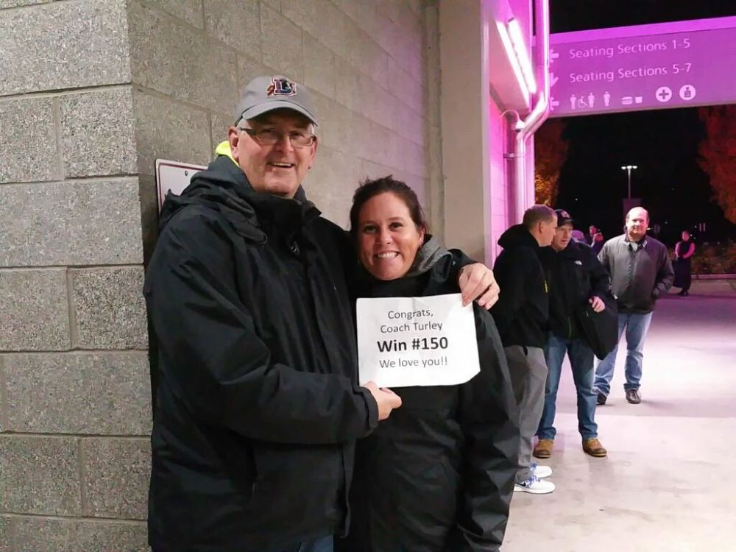
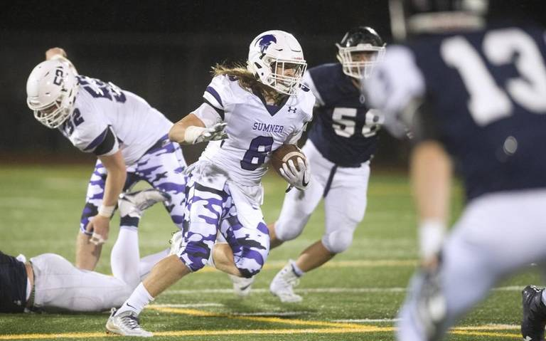
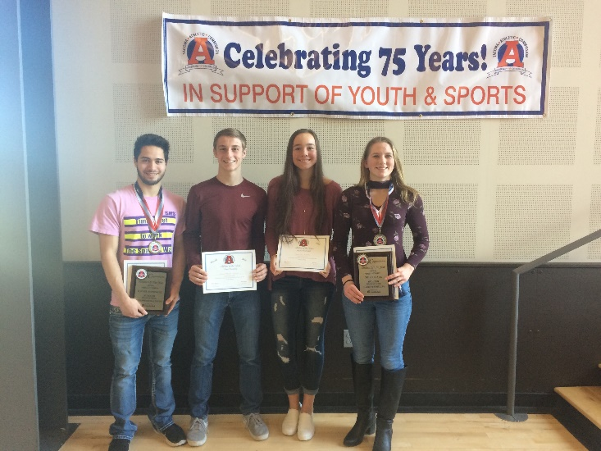
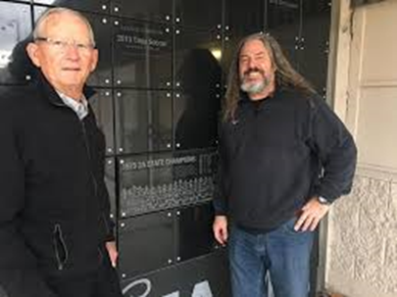
Some thing to look at…
Celebrate Others
It starts at “HOME”

Slide 28
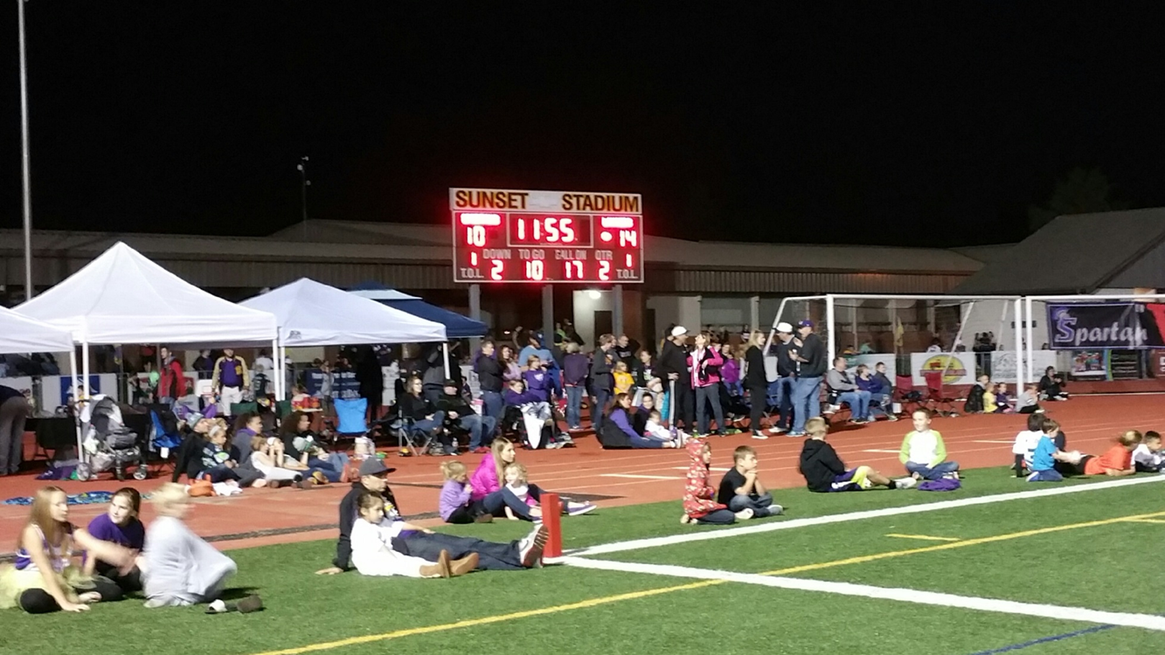
Some thing to look at…
Baines Land

Slide 29
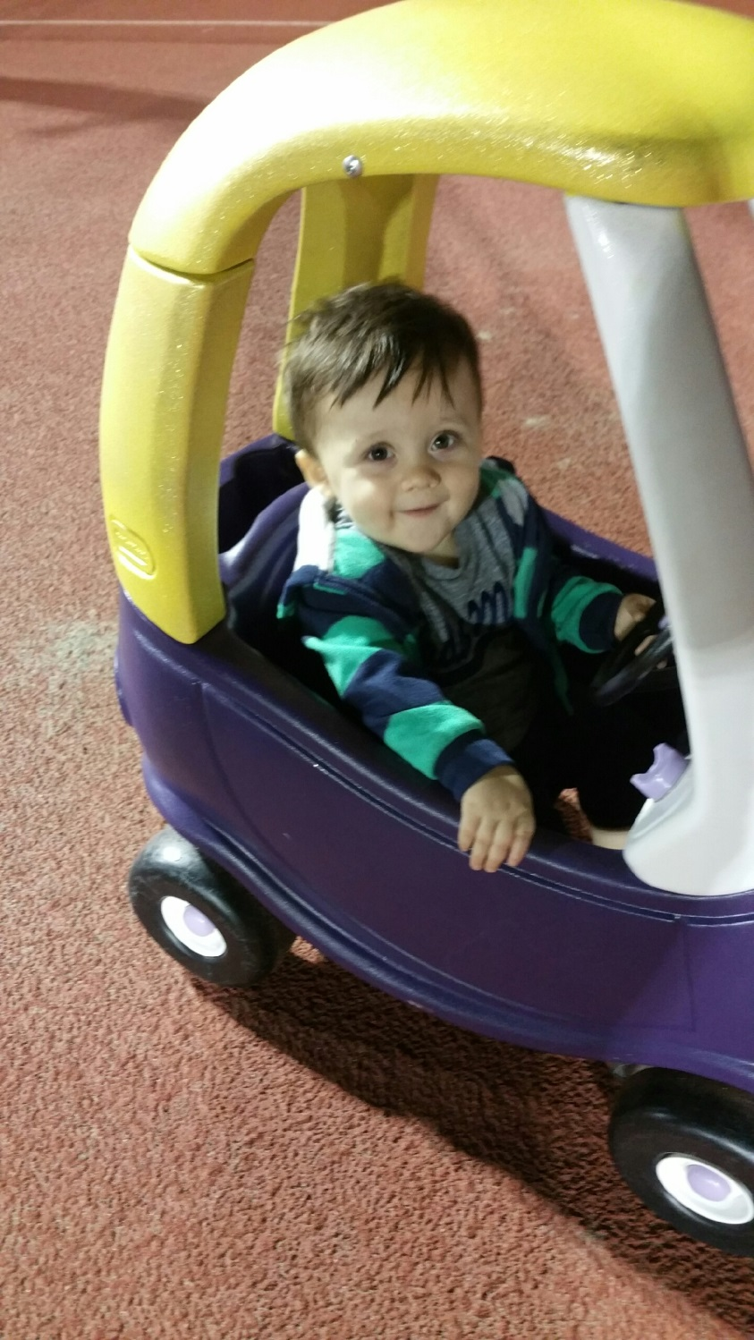
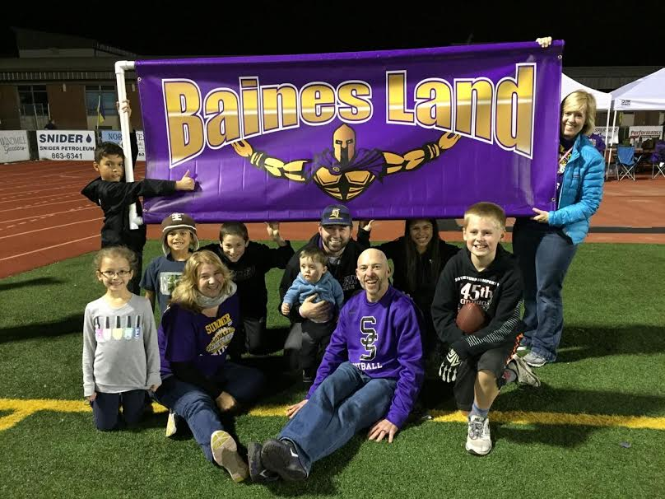
One person’s Vision…

Slide 30
Baines “CHALLENGE OF THE WEEK”
Baines challenge to @SumnerSpartans Put you fears and hesitations aside and trust YOUR journey.
Baines challenge to @SumnerSpartans Don't settle in your "comfort zone"; The courage to reach and explore out beyond will = growth & progress

Slide 31
Monday Morning Message

Slide 32
It’s about the IMPACT & INFLUENCE
How can I be a positive influence on others every day?
How can I serve others each and every day?
How can I EARN influence as a leader on this team and in this program?
Commit to you as an individual. This means I will work to know you in all ways.
Be gritty and persevere. This means I will be in the trenches reflecting and adjusting from challenges and failures.
Be respectful to you before you are to me. This means I believe I have to earn your respect. It also means that once I have it, I need to work to maintain it.
Be humble, honest, and forgiving. This means I will own my mistakes and always tell you the truth about your own but will ALWAYS forgive you.
Be selfless for the team. This means I will put the needs of the team above my own.

Slide 33
It’s not about the destinations…

Slide 34
Find your “path” to follow
The courage to step into the arena is much more important than any outcome. It’s all about the journey
Jeff Baines

Slide 35
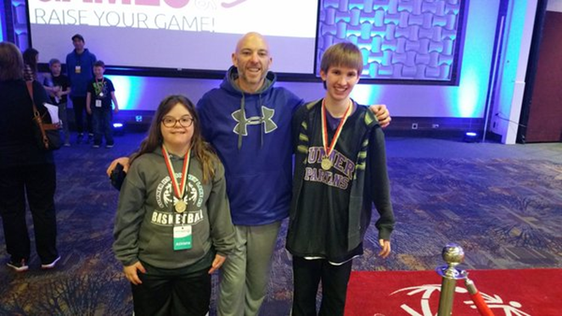
In the end…
It’s about the relationships

Slide 36
Remember the post-it?
In the next 24 hours, write a thank you note to someone that has been a positive influence for you in your life.
Next level: Call that person and let them know how you feel

Slide 37
THANK YOU!
Jeff Baines
Sumner High School
Assistant Principal
Athletic Director
ASB/Activities
Office: (253) 891-5543
Cell: (360) 829-7284
Email: jeffrey_baines@sumnersd.org
Twitter: @BainesJeff

