Slide 1
Setting the Tone for Your Athletic Department
Erik Titus, CAA
Anacortes High School
Dr. Derek Tucci
Kenmore Jr. High
WSSAAA Conference 2016

Slide 2
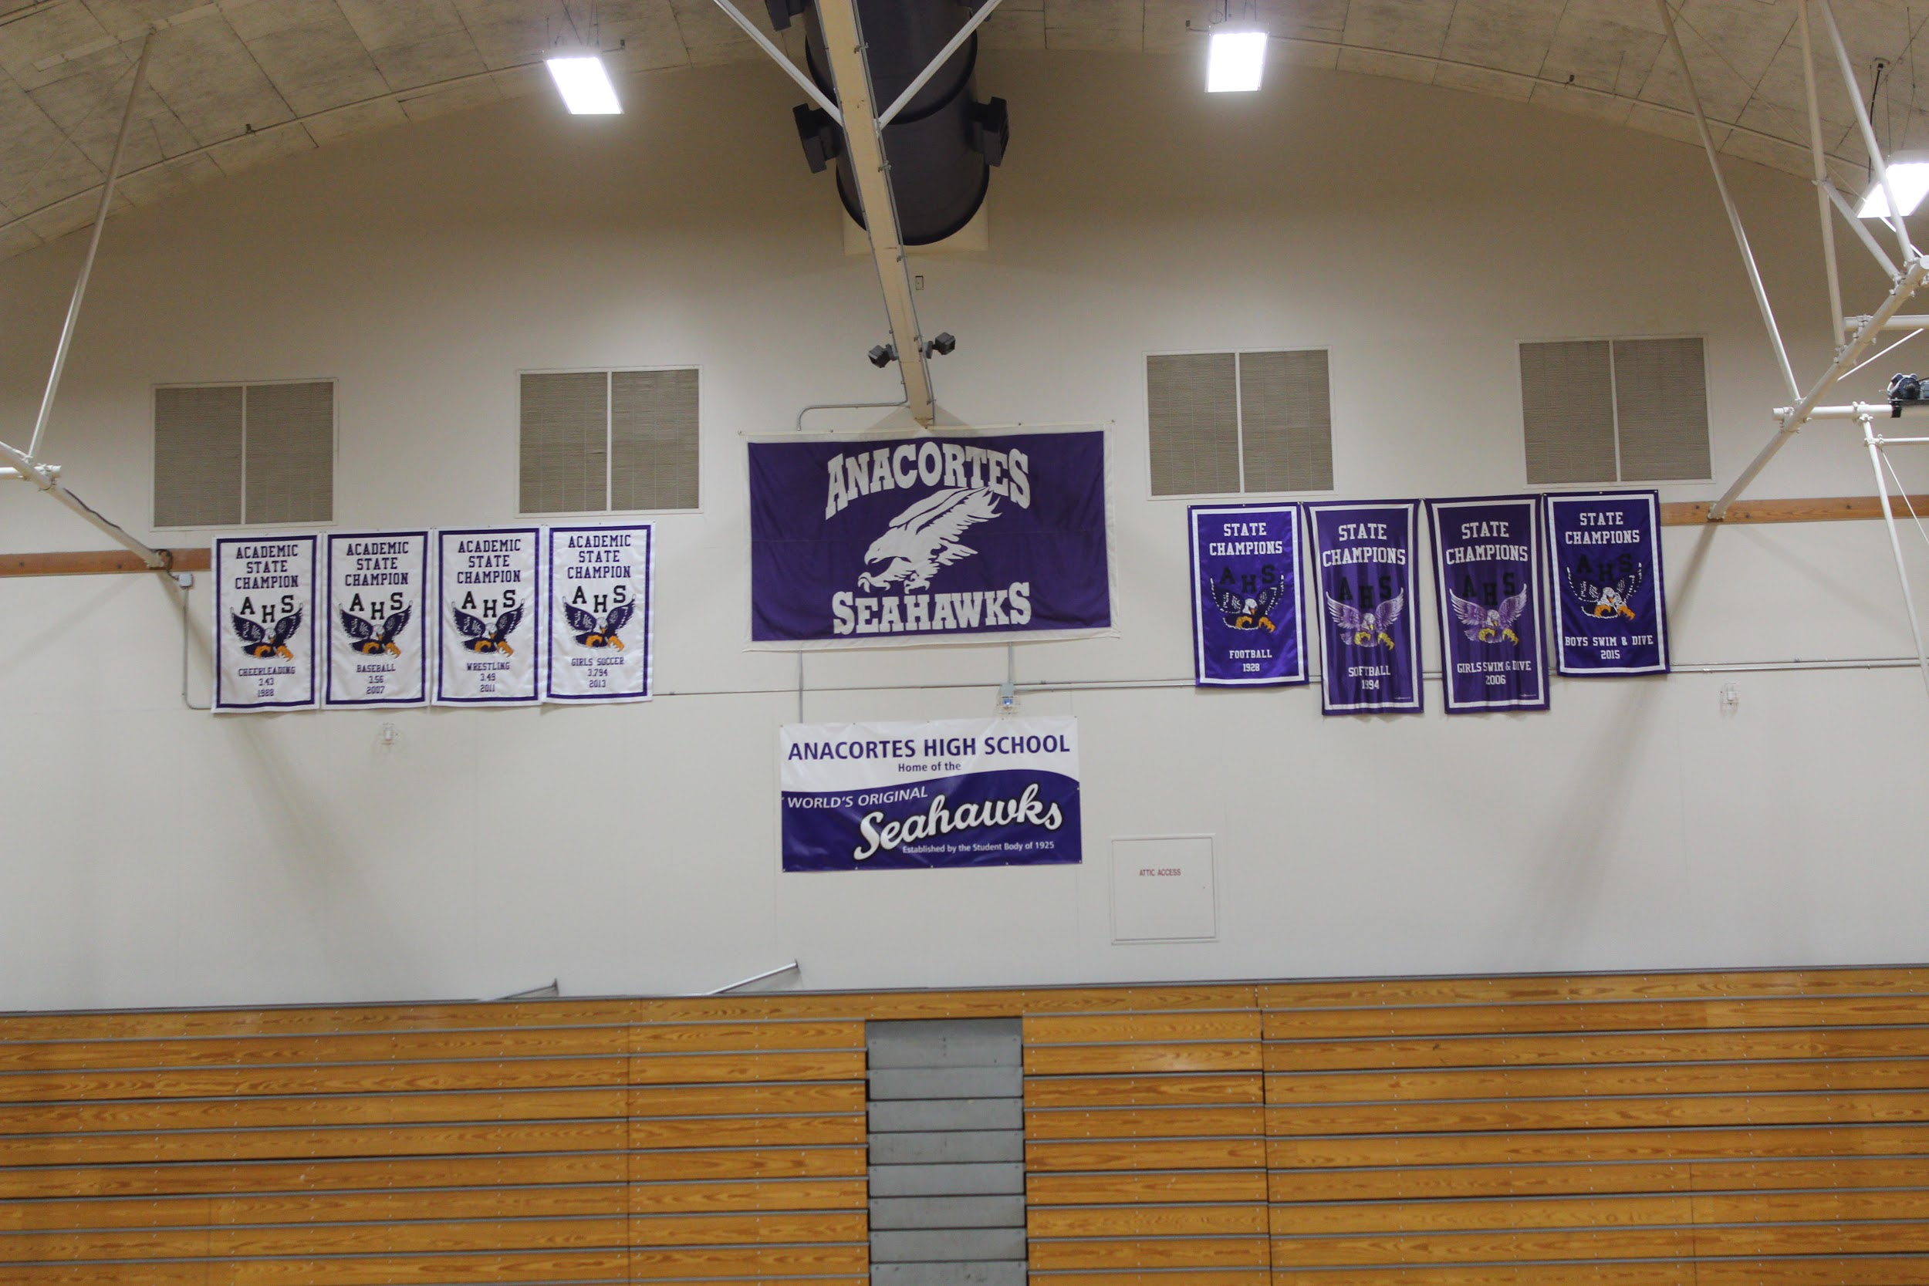

Slide 3
Assistant Principal Activities & Athletic Director
Job Description – Oversee Athletics, Activities, & ASB
New Stadium
New School

Slide 4
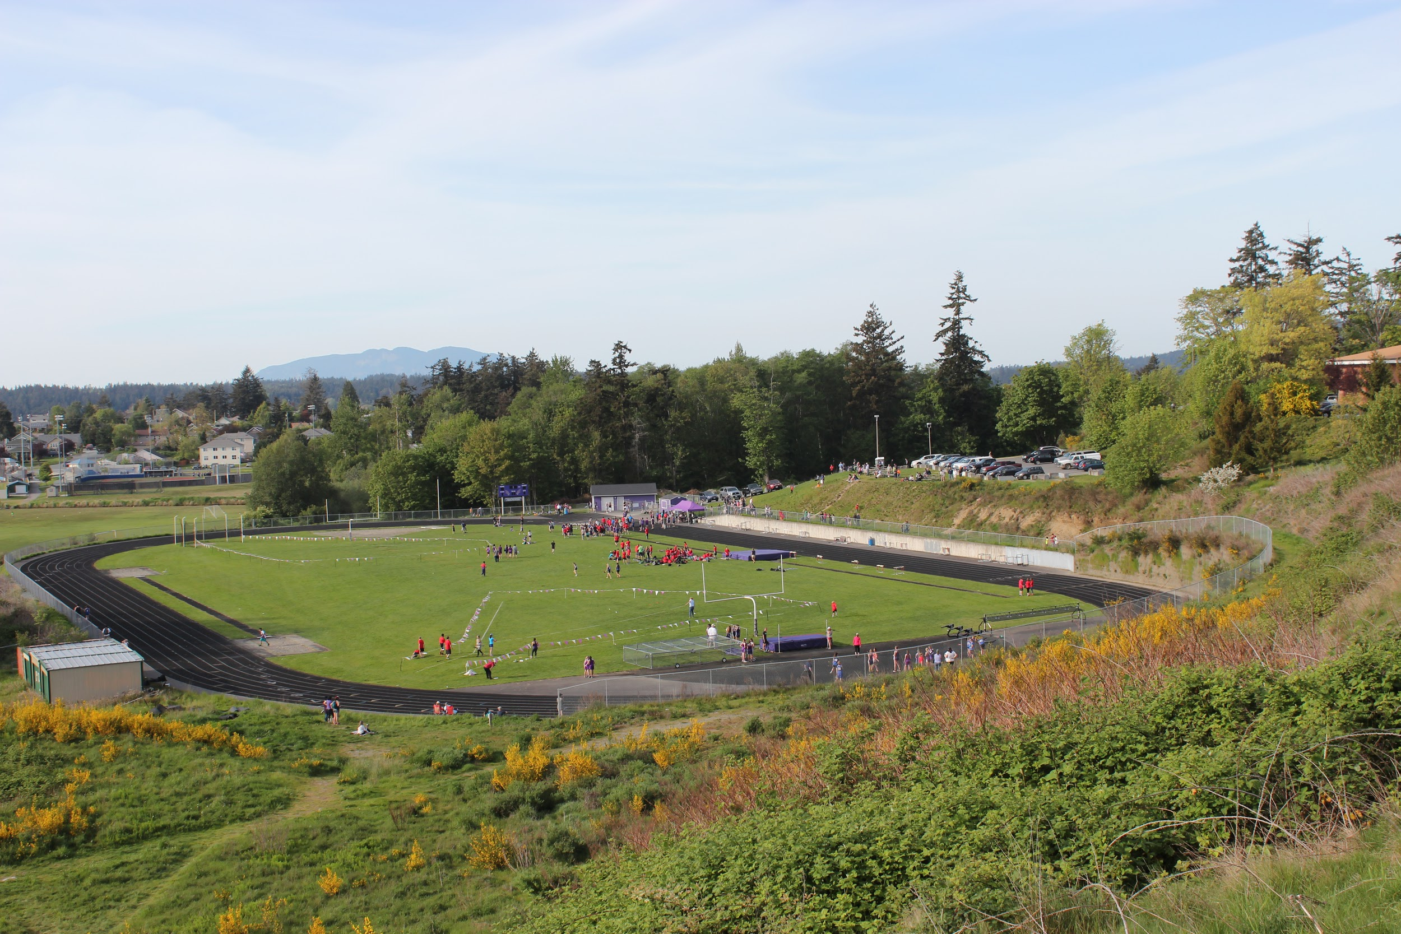
New Stadium Site

Slide 5
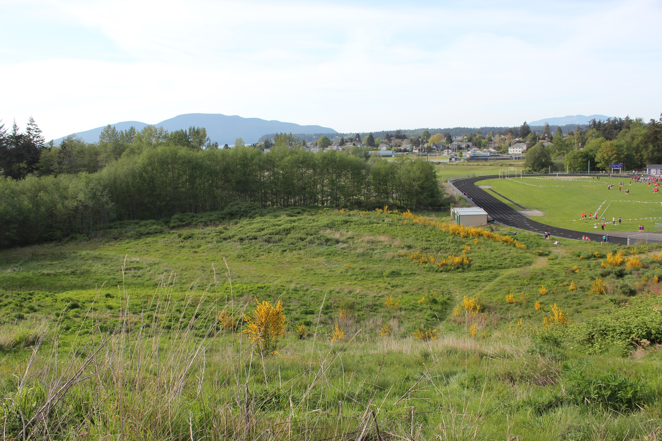
Throwing Venues @ Rice Field

Slide 6
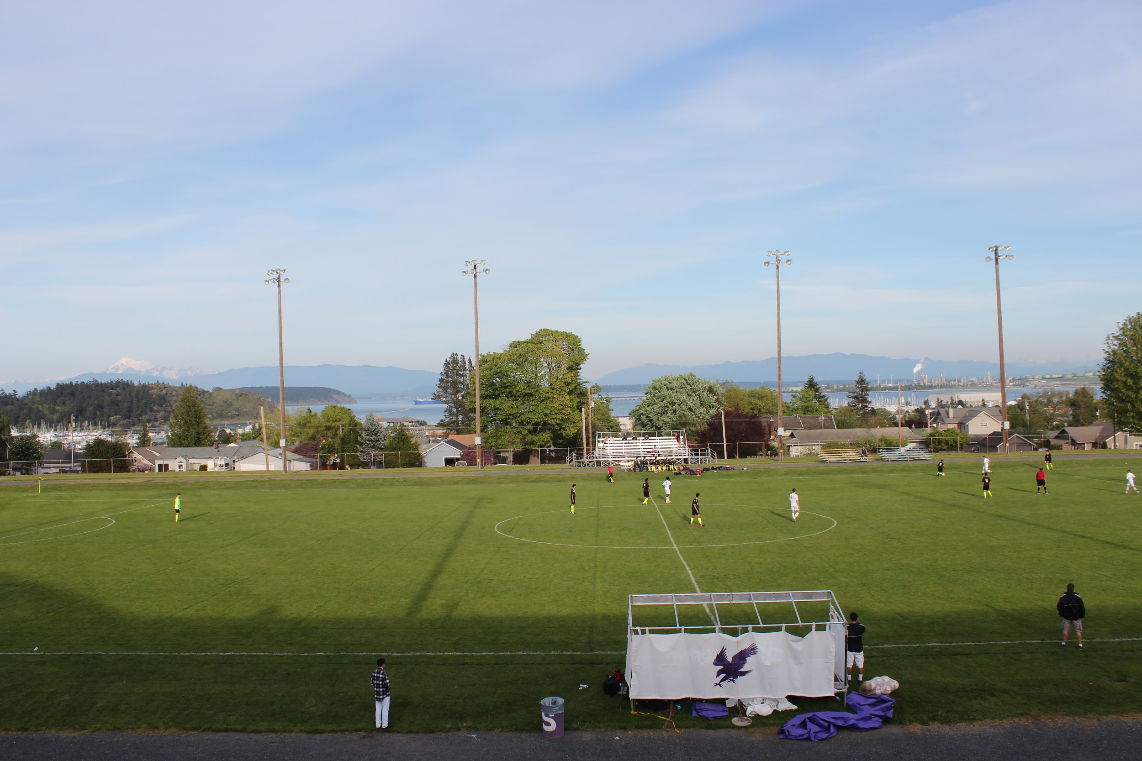
War Memorial Field

Slide 7
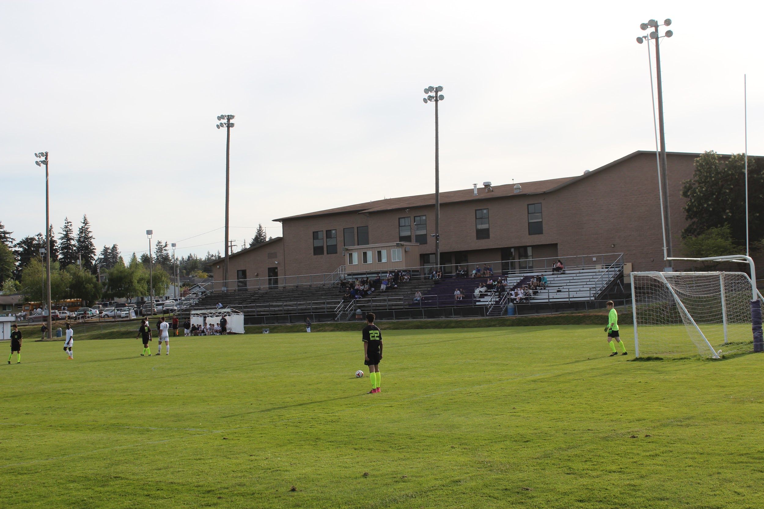

Slide 8
Assistant Principal Activities & Athletic Director
Job Description – Oversee Athletics, Activities, & ASB
Girls Dive Coach
Head Wrestling Coach/Staff
New Stadium
Head Girls Tennis Coach/Staff
New School
Head FB Coach
Head Girls Soccer Coach/Staff
Athletic Trainer
Bowling Coach
Boys Dive Coach

Slide 9
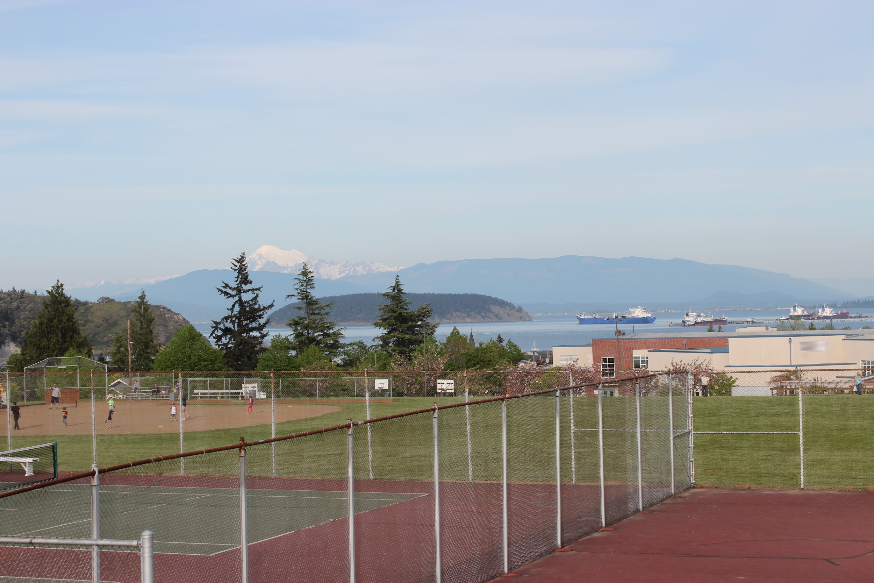

Slide 10
Assistant Principal Activities & Athletic Director
Job Description – Oversee Athletics, Activities, & ASB
Girls Dive Coach
Head Wrestling Coach/Staff
Head Baseball Coach/Staff
New Stadium
Head Girls Tennis Coach/Staff
Head FB Coach
New School
Head Girls Soccer Coach/Staff
Head Boys Golf Coach
Boys Dive Coach
Bowling Coach
Athletic Trainer

Slide 11
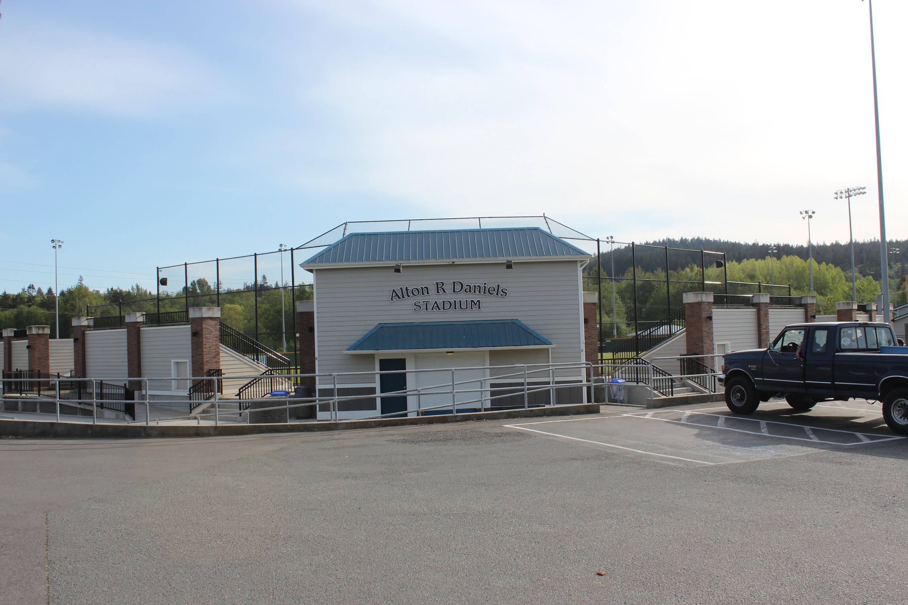

Slide 12
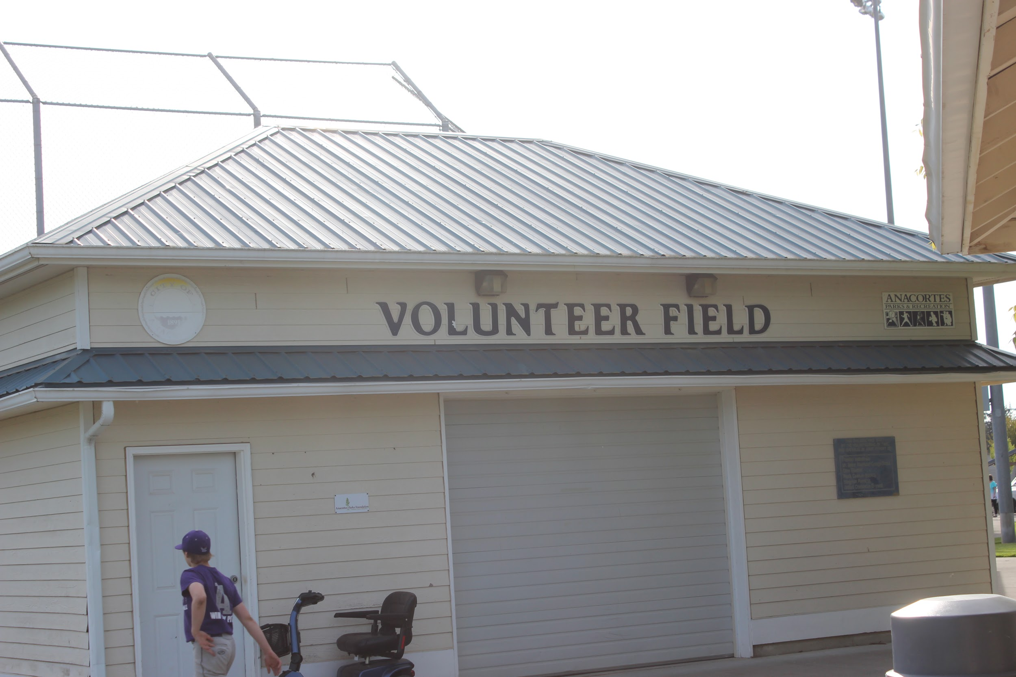
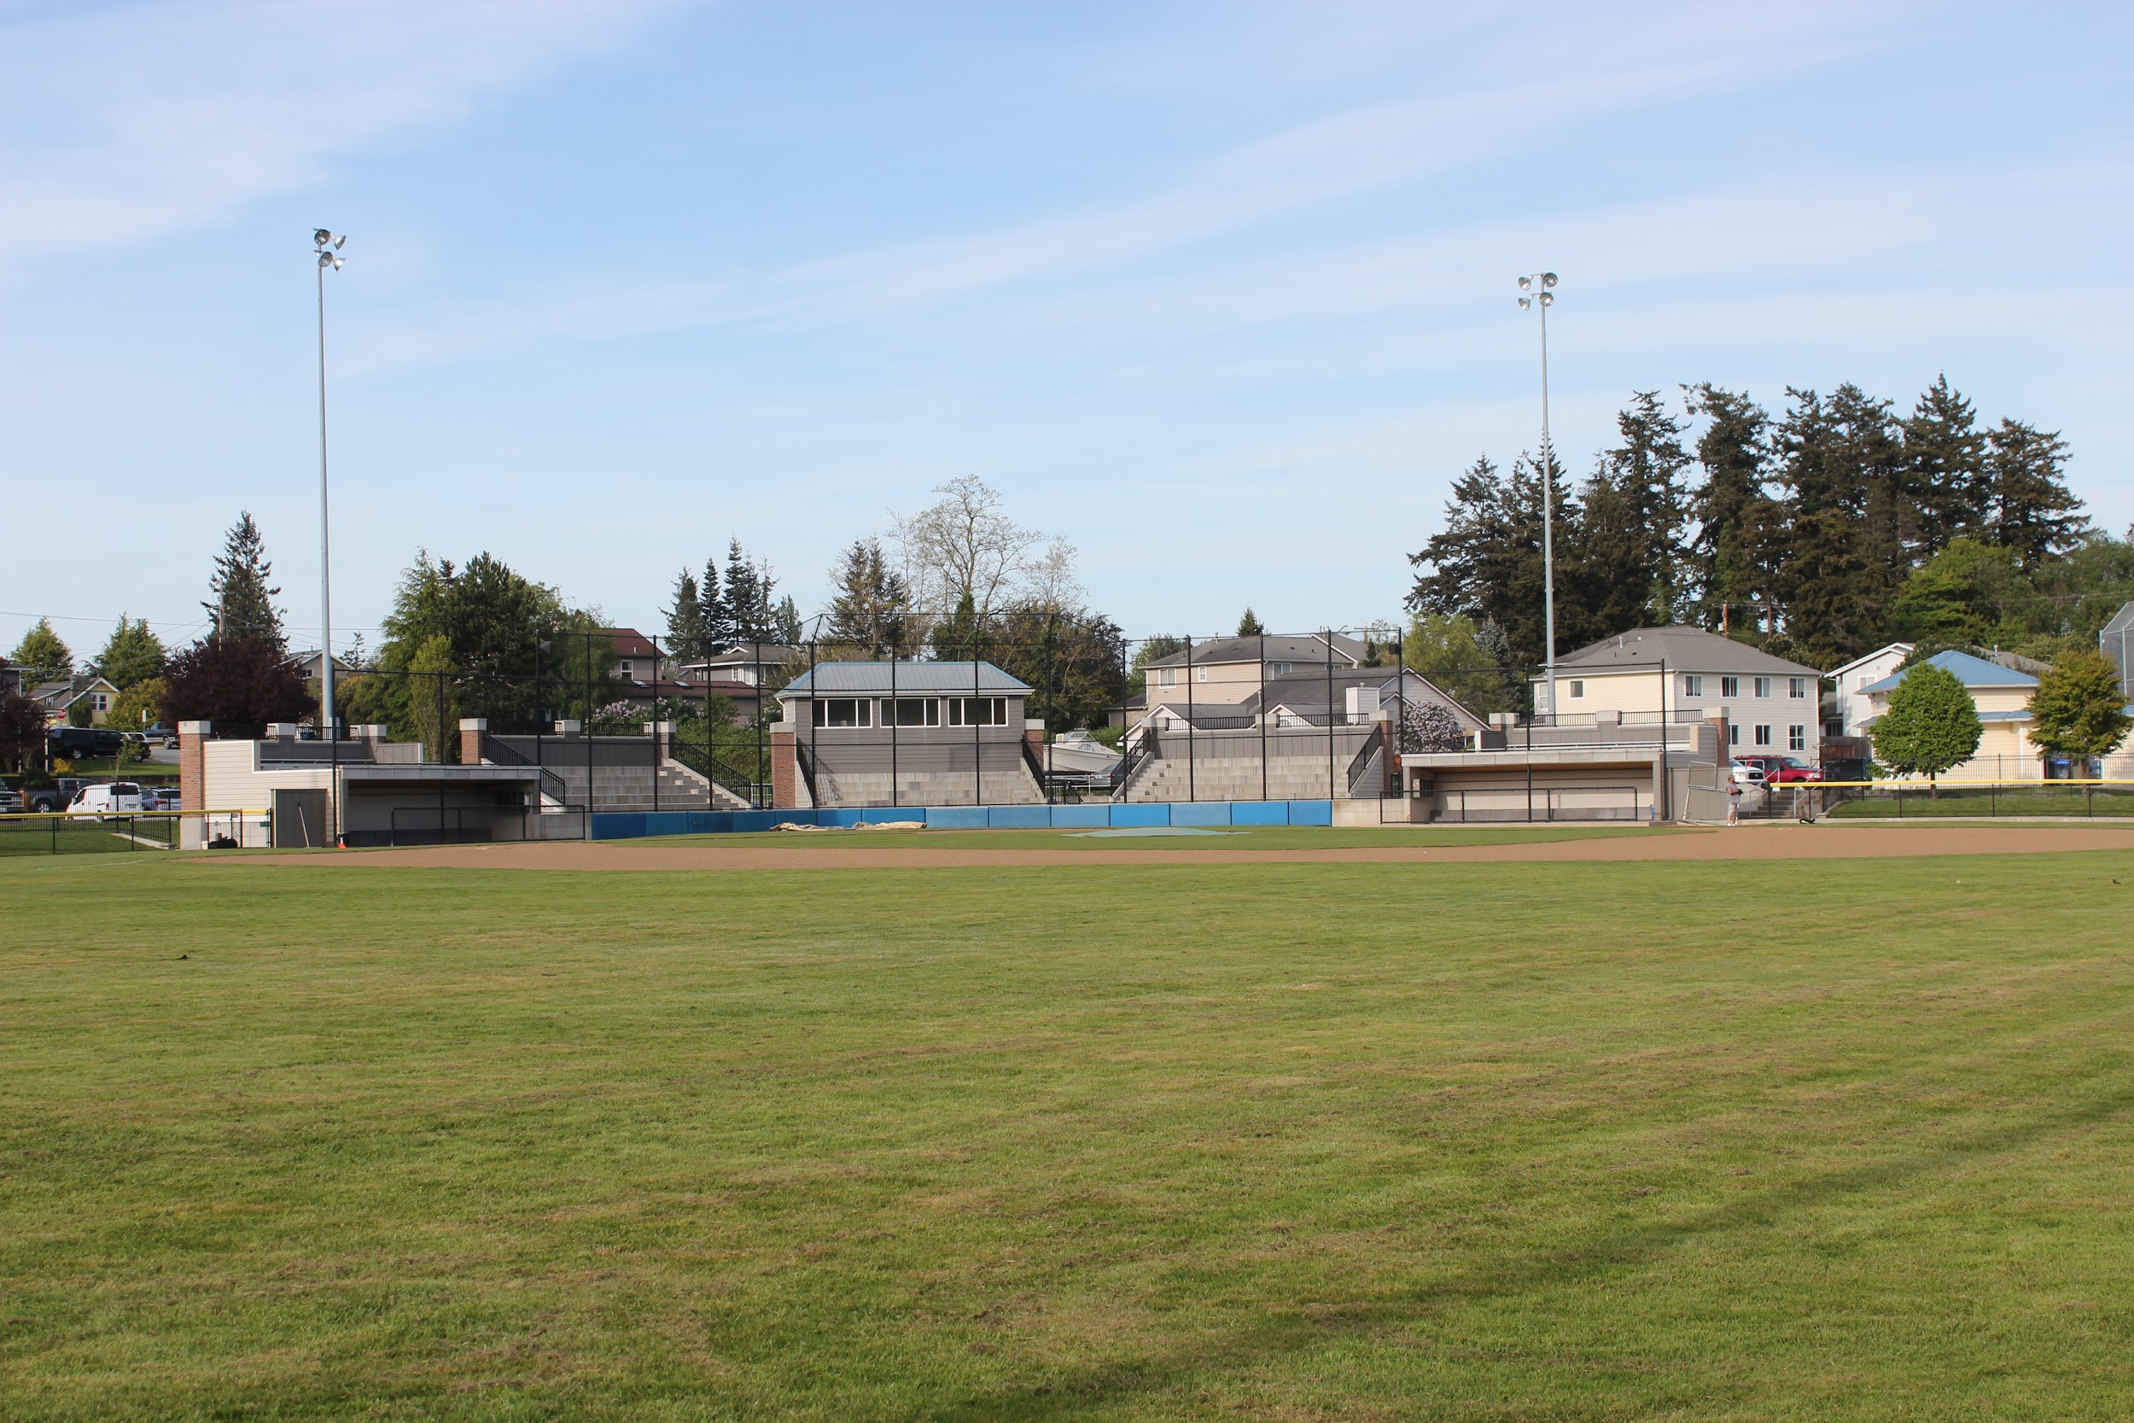

Slide 14
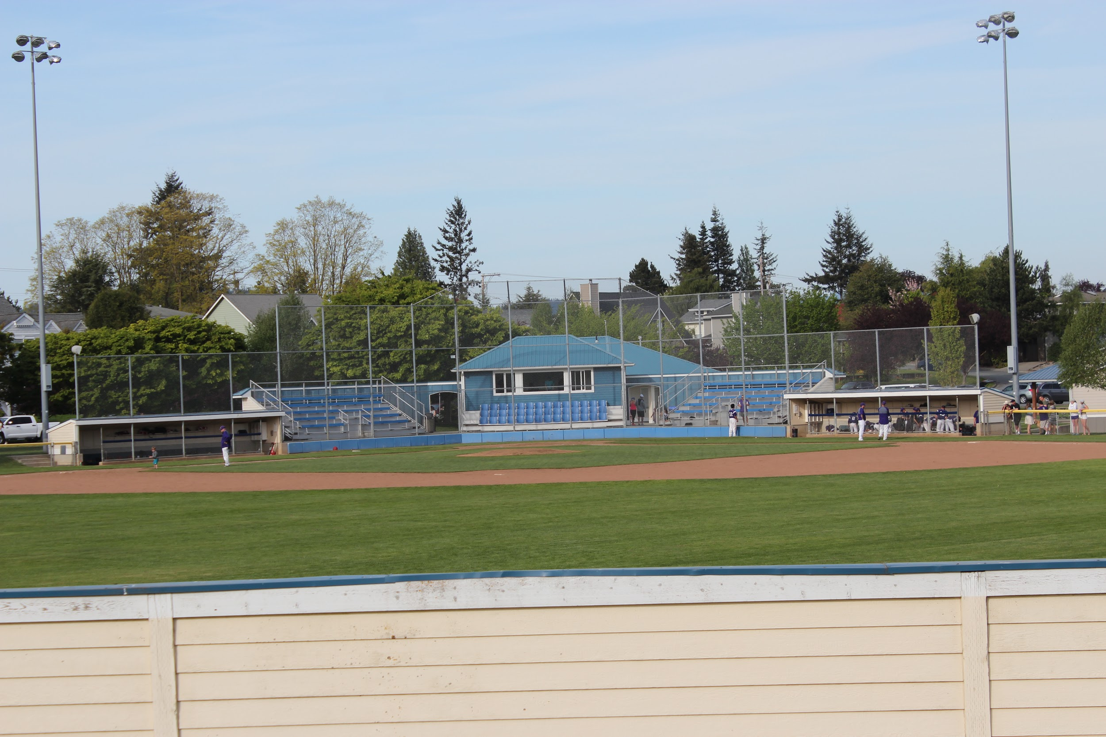

Slide 15
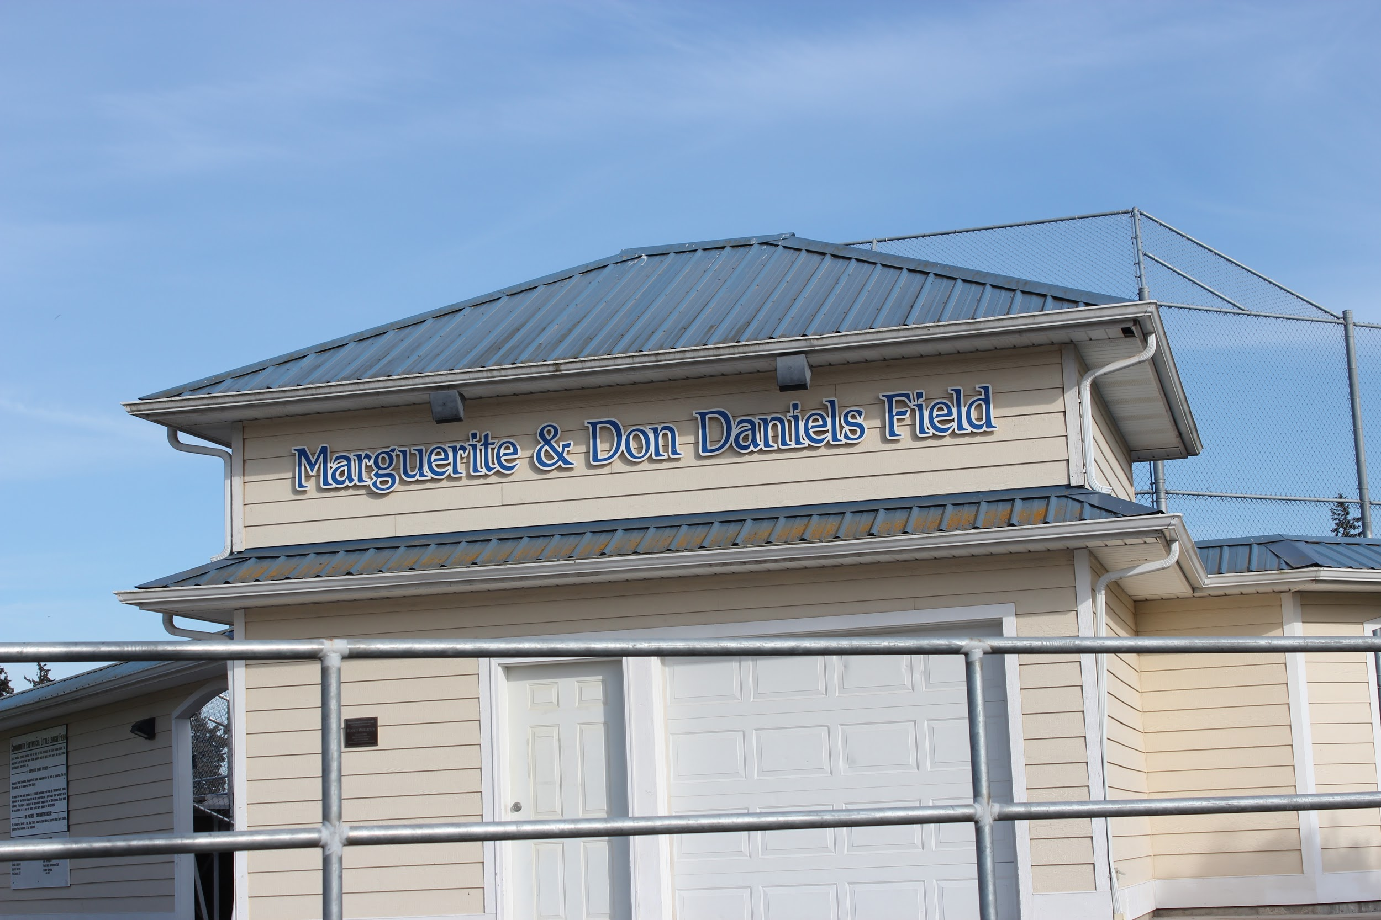

Slide 16
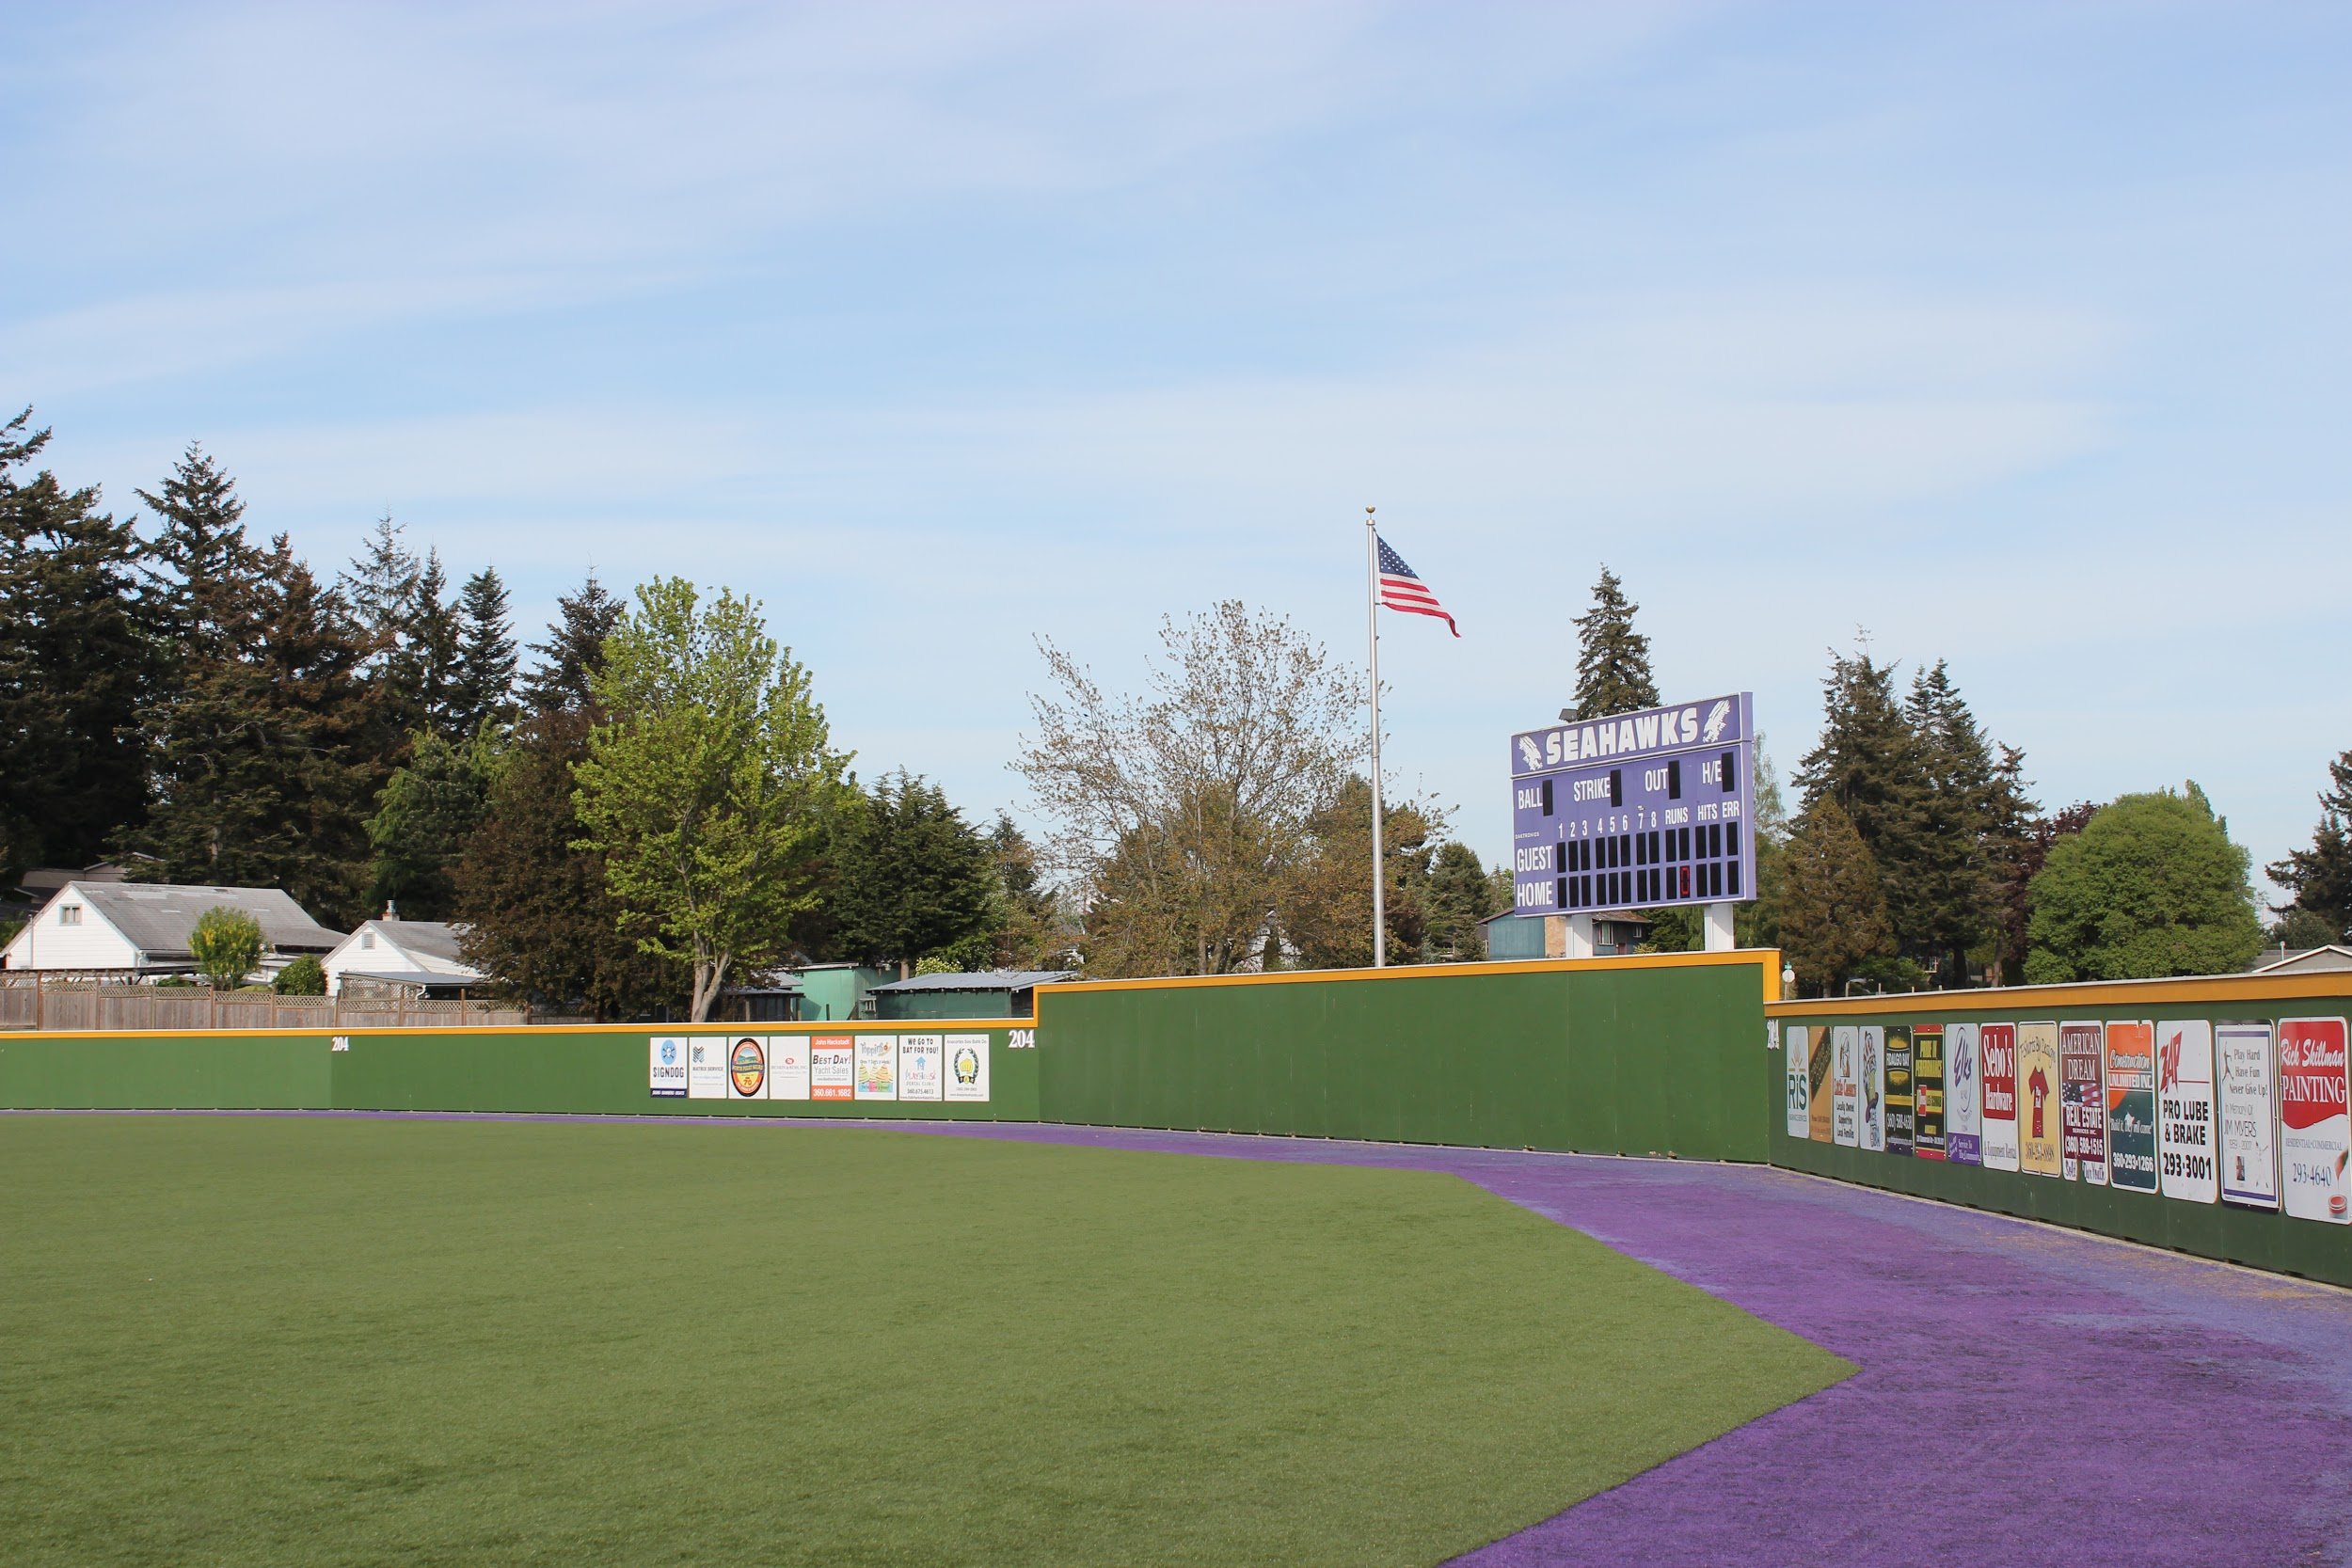

Slide 17
7 Habits of Highly Effective People
Be Proactive
Begin with the End in Mind
Put First Things First
Think Win-Win
SeeK First to Understand, Then to be Understood
Synergize
Sharpen the Saw

Slide 18
Nine Characteristics of High Performing Schools
Clear & Shared Purpose
High Standards & Expectations for All Students
Effective School Leadership
High Levels of Collaboration and Communication
Curriculum, Instruction, and Assessment Aligned with State Standards
Monitoring of Teaching & Learning
Focused Professional Development
Supportive Learning Environment
Family/Community Involvement

Slide 19
Where Do You/Did I Start?
Managers do things right; Leaders do right things
Transparent
Be Visible to be Valuable
Proactive
Put Me in a Position to Support You
Make/Take the Time to Meet to Discuss Athletic Philosophy
Hire those who are GREAT with kids; develop relationships

